Slide 1




A numerical approach for the design of coastal protection works in the eastern Giens tombolo
PhD candidate: Minh Tuan VU
Supervisor: Yves LACROIX
SEATECH, University of Toulon, France and MEMOCS, Università Degli Studi dell’Aquila, Italy
Toulon, France
February, 28th 2018

Slide 2
CONTENT
1. INTRODUCTION
2. SITE DESCRIPTION
3. METHODOLOGY
4. DISCUSSION OF MORPHOLOGICAL CHANGES
5. DISCUSSION OF HYDRODYNAMICS AND SAND TRANSPORT
6. PROPOSAL OF PROTECTIVE MEASURE
7. CONCLUSION

Slide 3
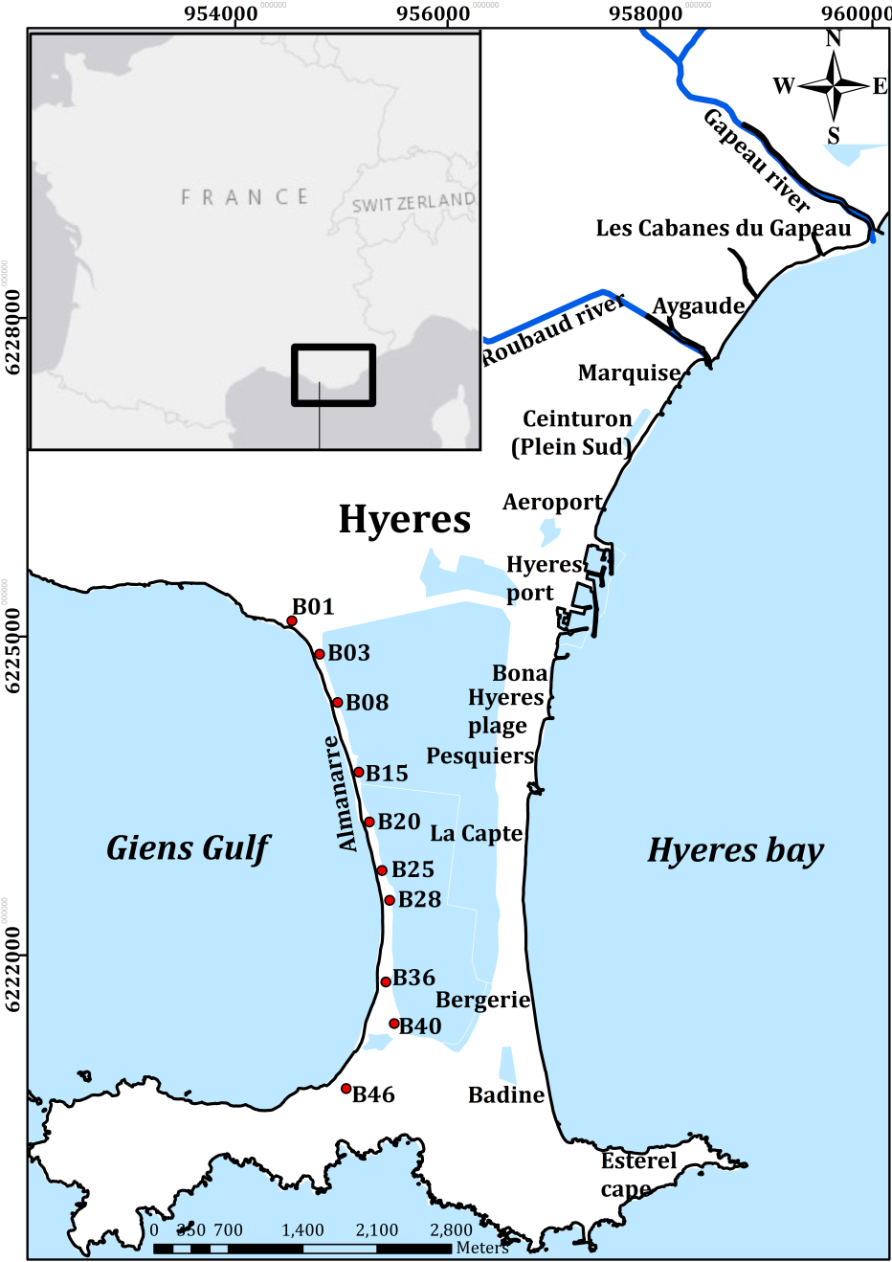
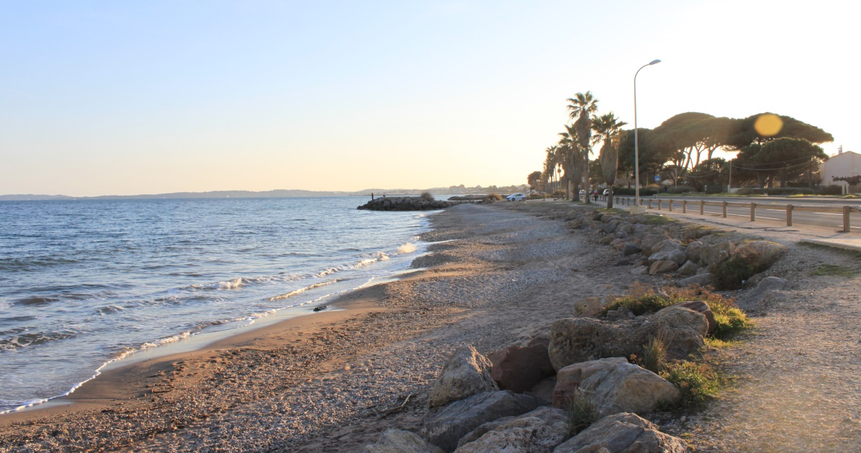
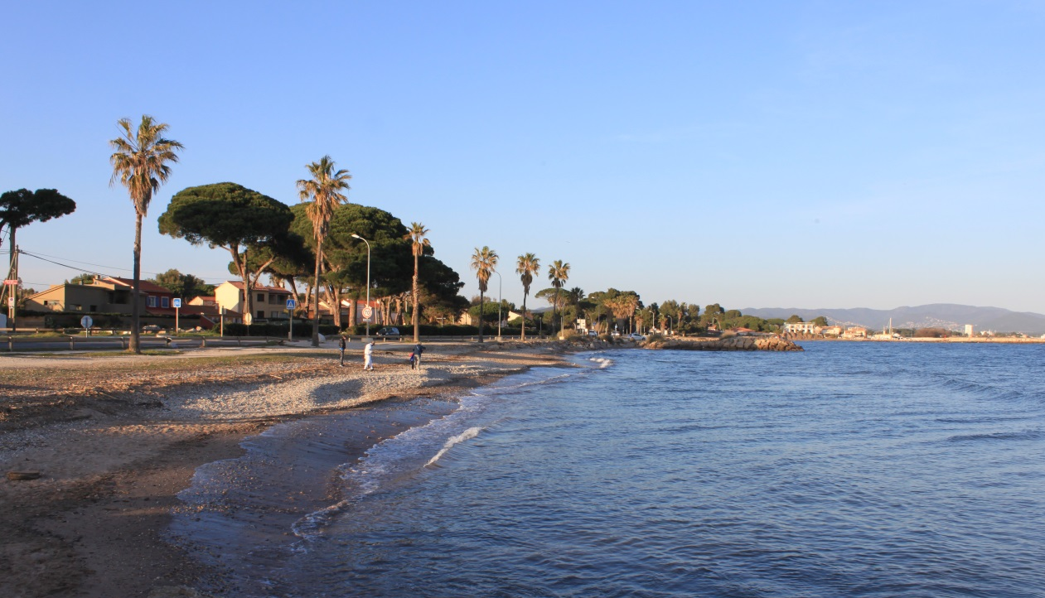
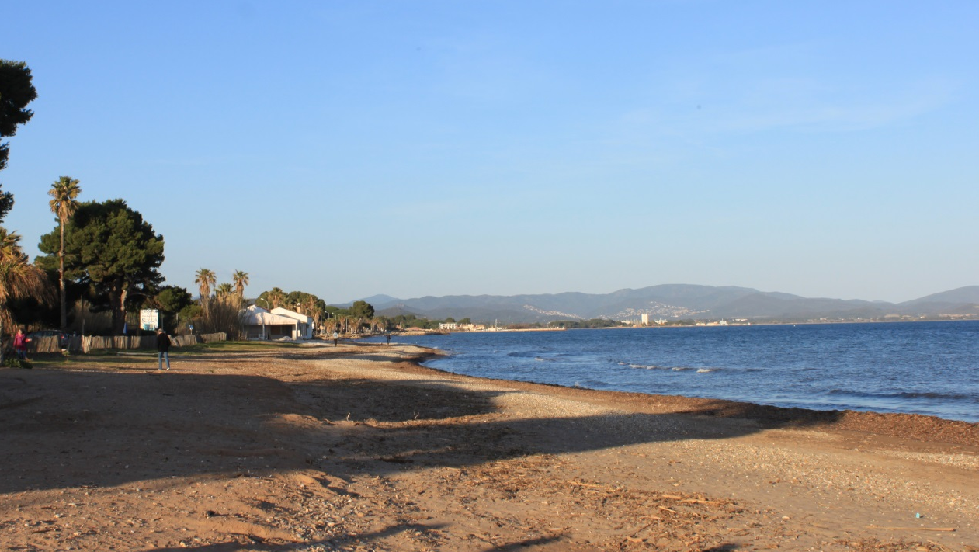
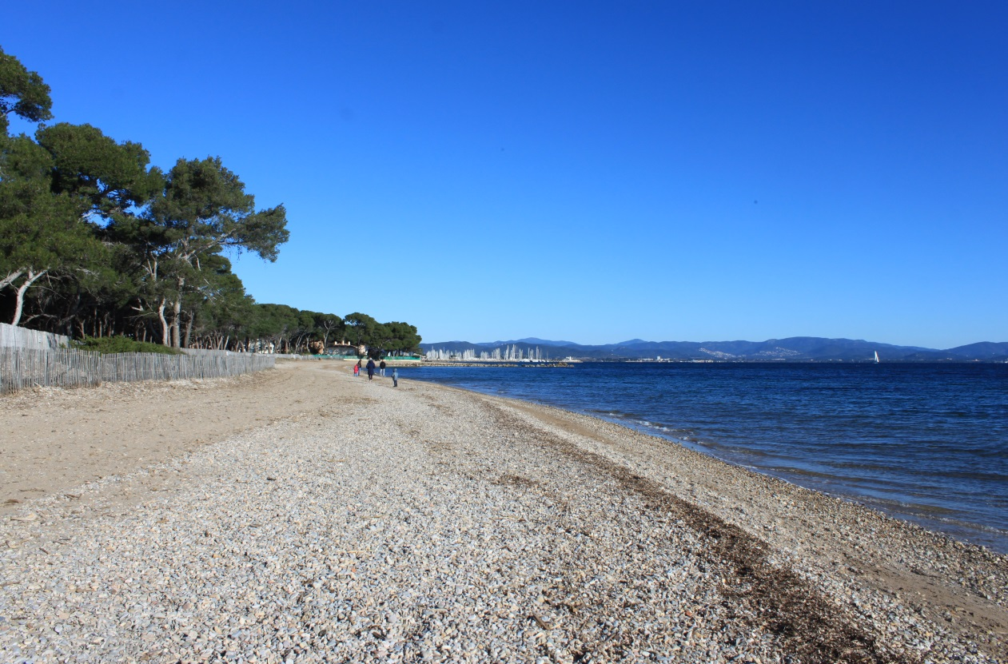
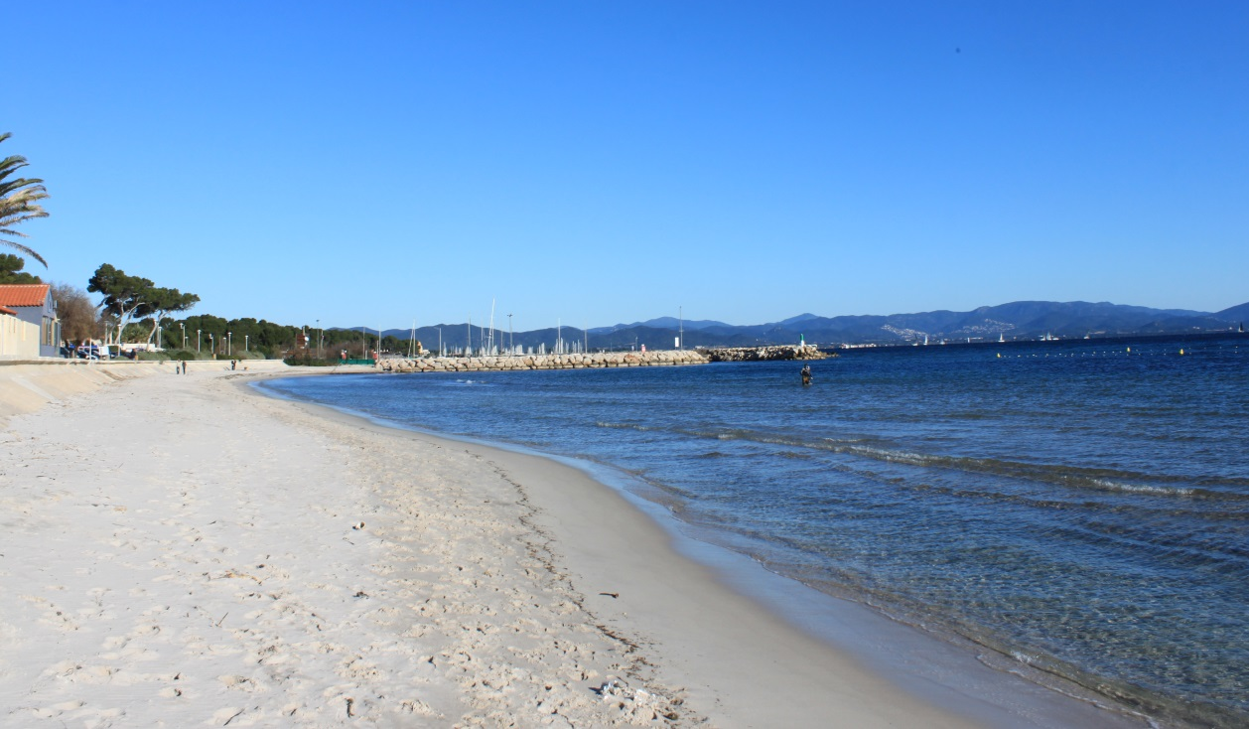
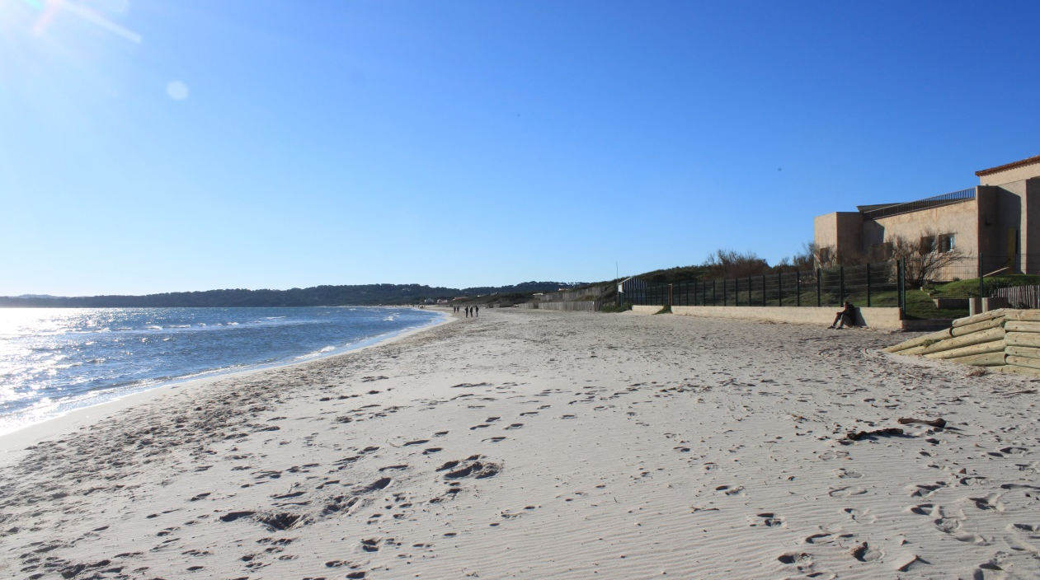
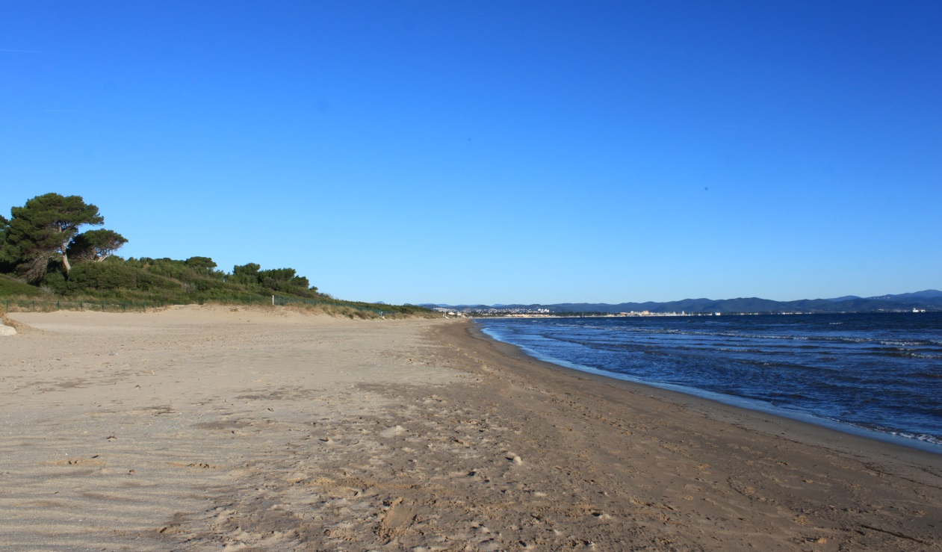
1. INTRODUCTION

Slide 4
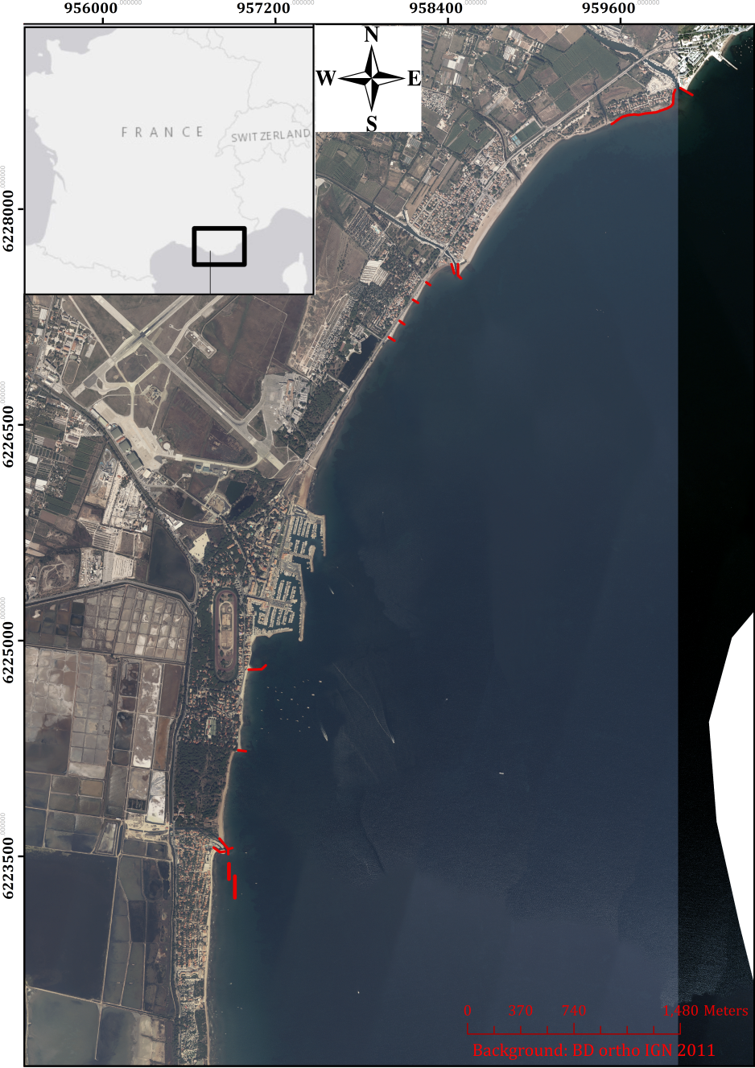
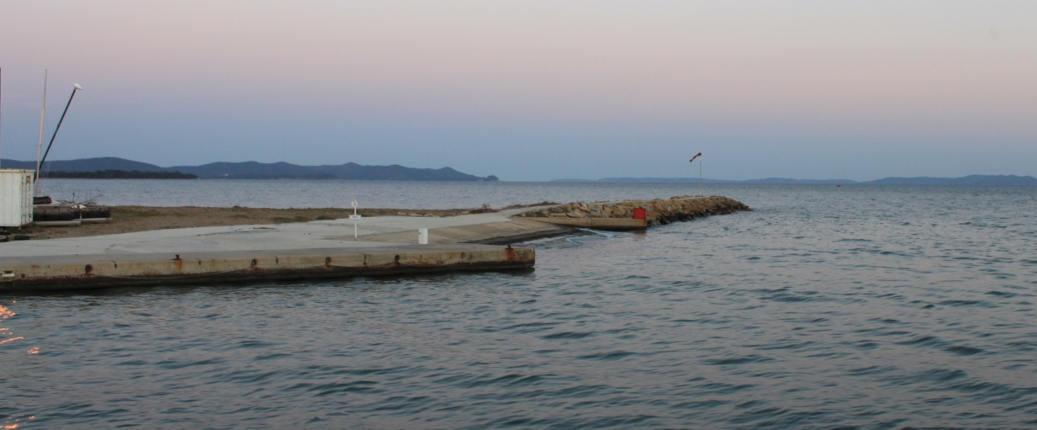
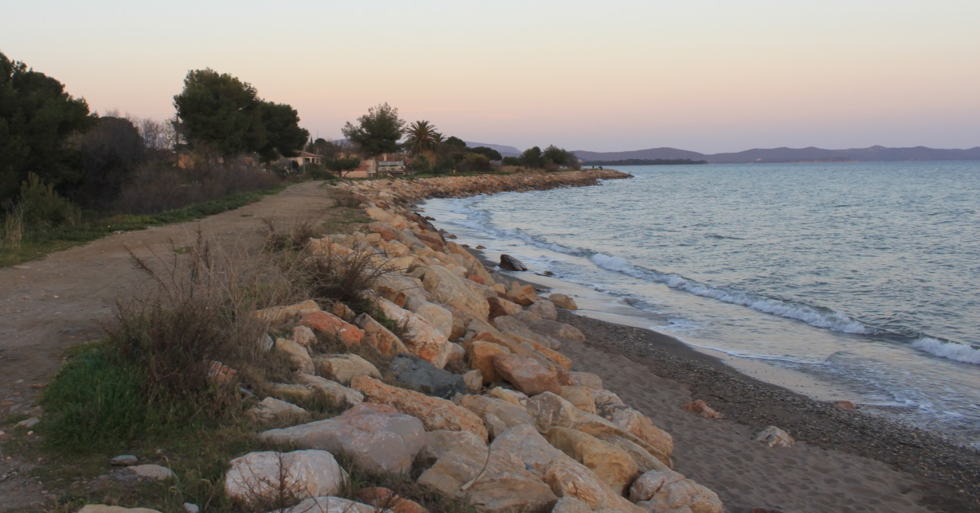
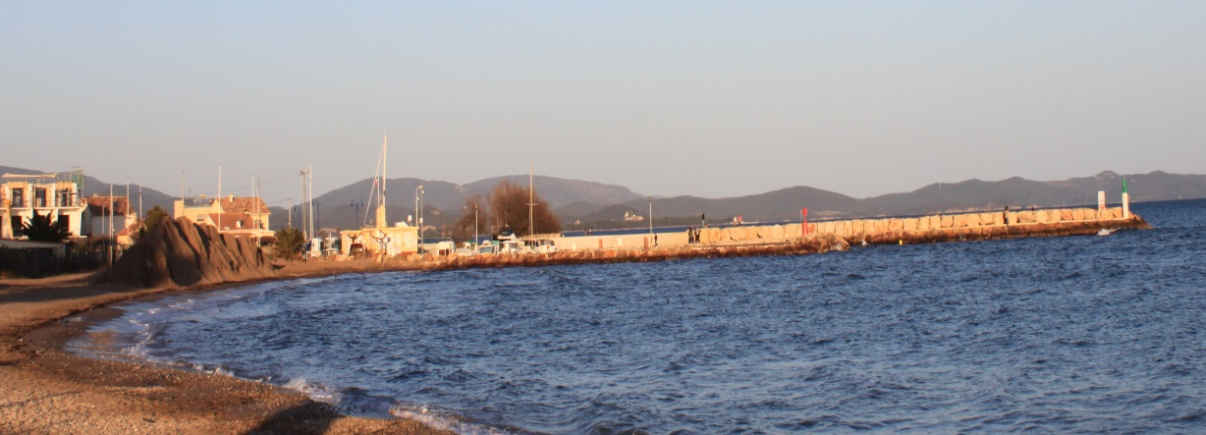
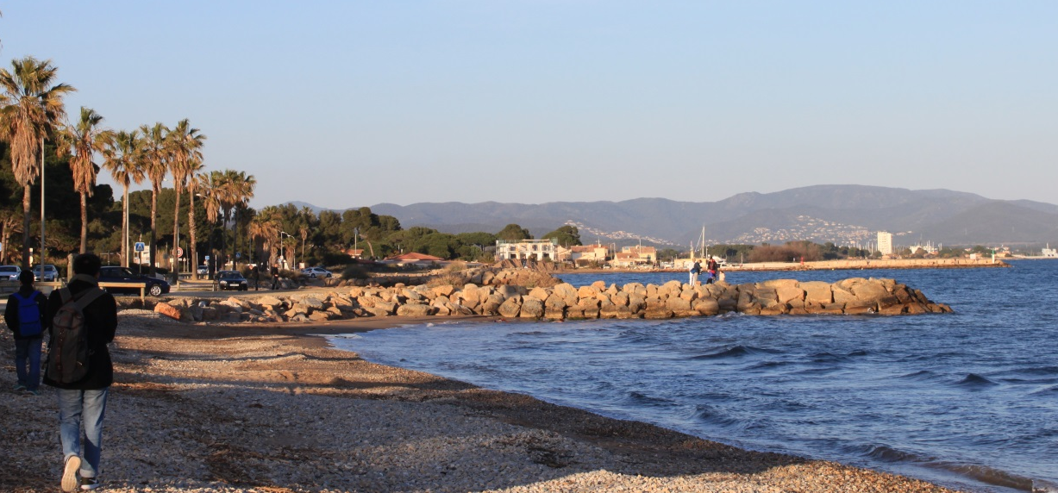
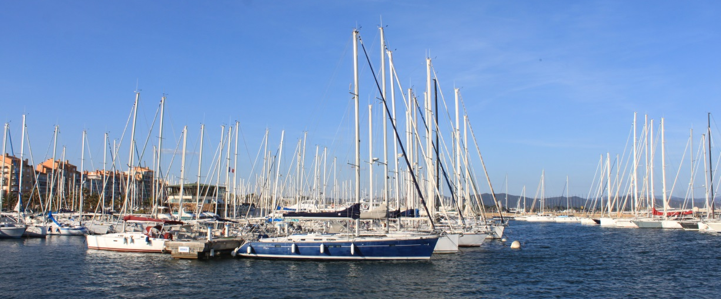
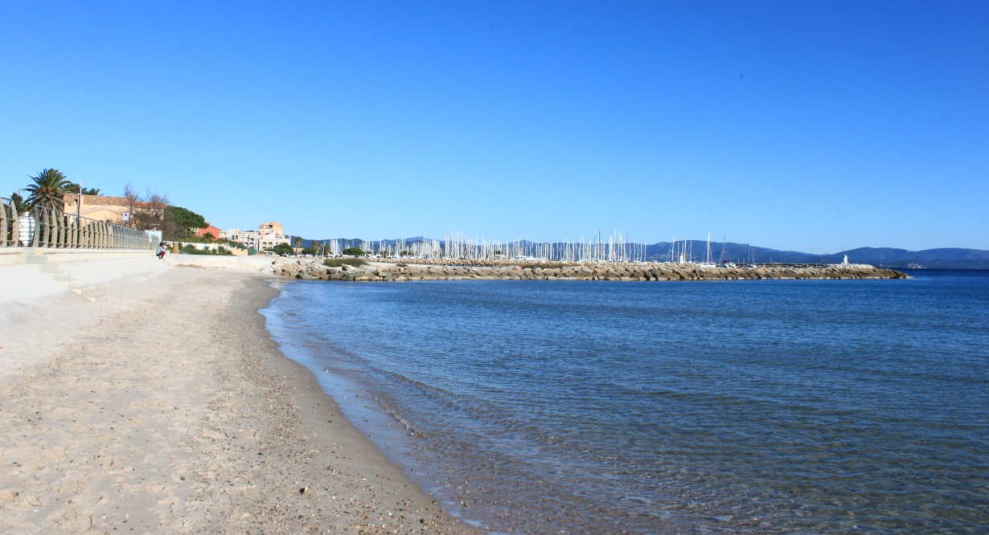
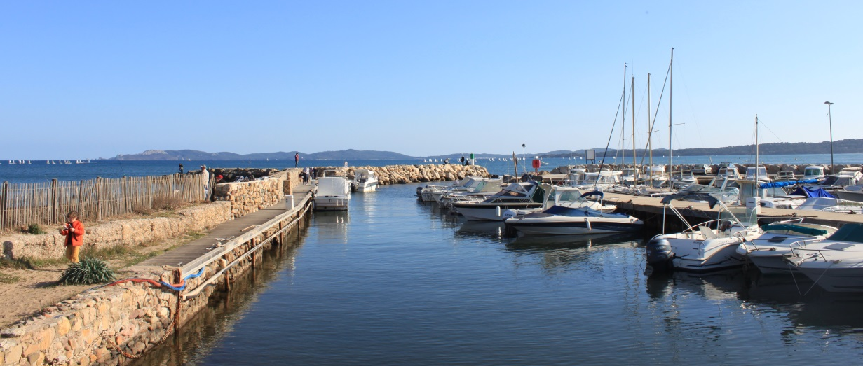
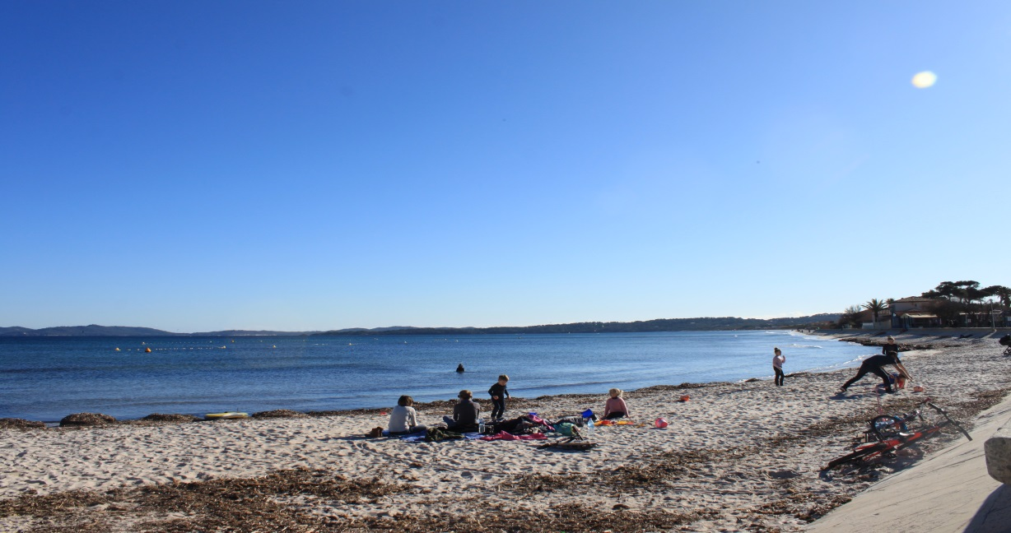
1. INTRODUCTION
In addition to port constructions, many coastal structures have been built along the east Giens tombolo to prevent erosion since 1950.
The 100m-long jetty in the left bank of Gapeau river in 1960
The 500m-long riprap in the right bank of Gapeau river in 1965
The jetties of Roubaud river in 1955-1960
Four 50m-long groynes in North Ceinturon in 1978-1982
First basin in 1952
Second basin in 1960,
Third basin in 1973
Two groynes in Bona beach in 1960 and seawall in 2008
The jetties of La Capte port in 1950-1955
Two geotube submerged breakwaters and seawall in La Capte port in 2008

Slide 5
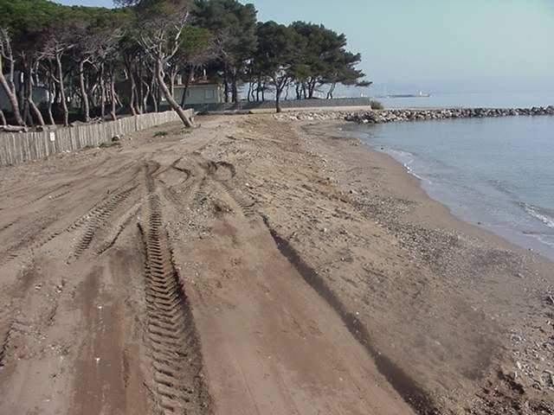
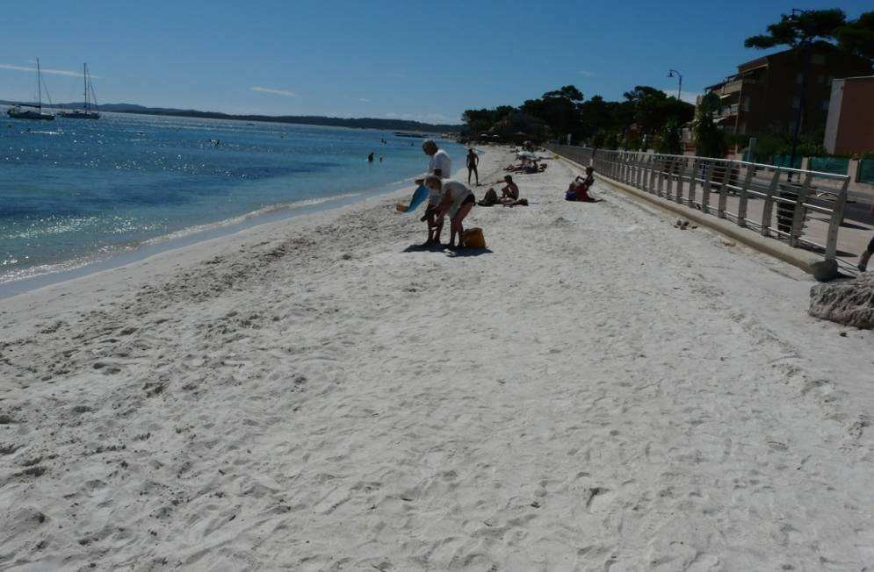
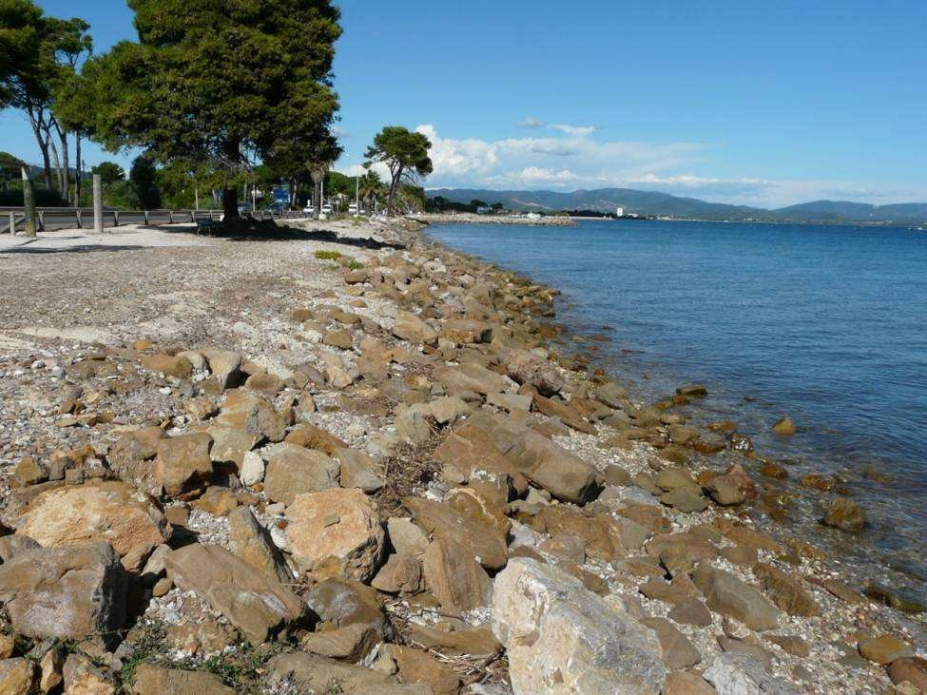
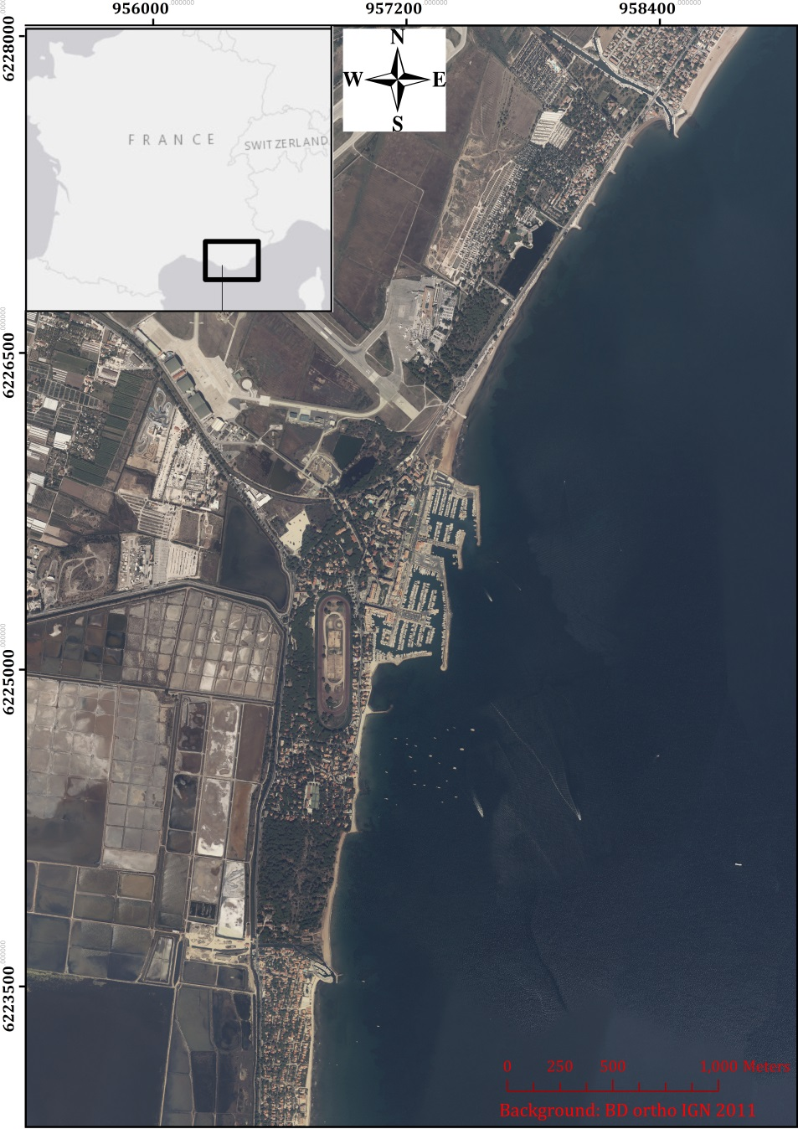
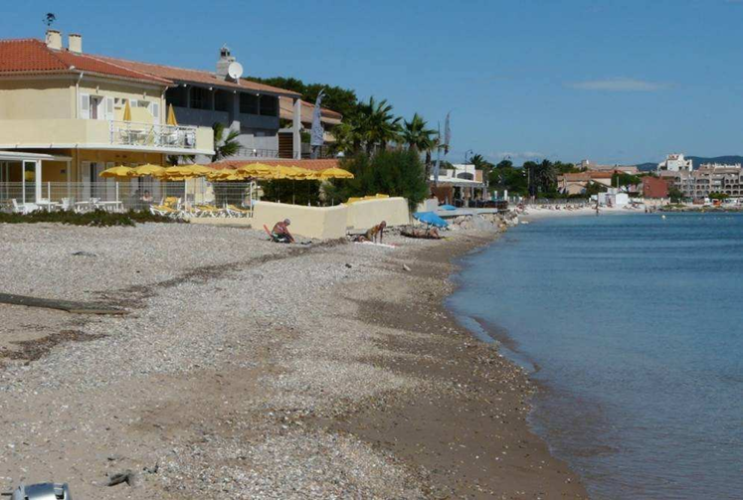
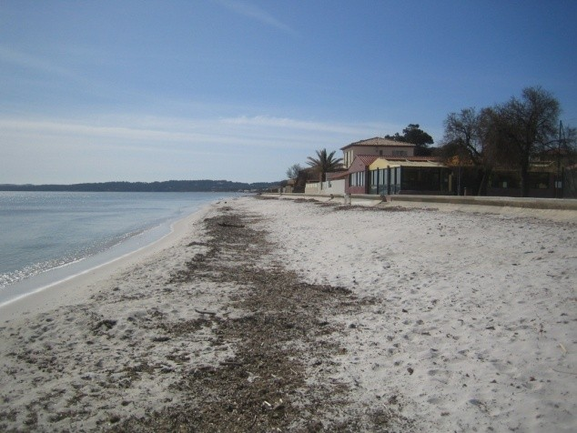
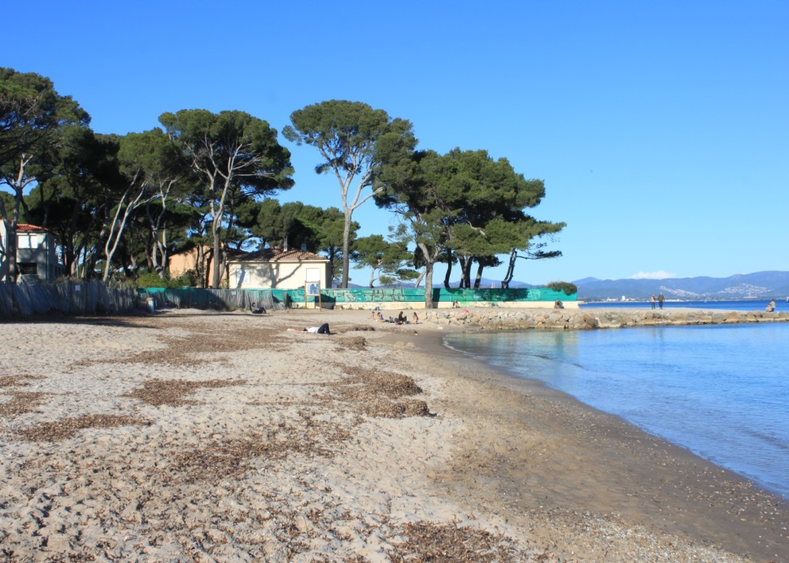
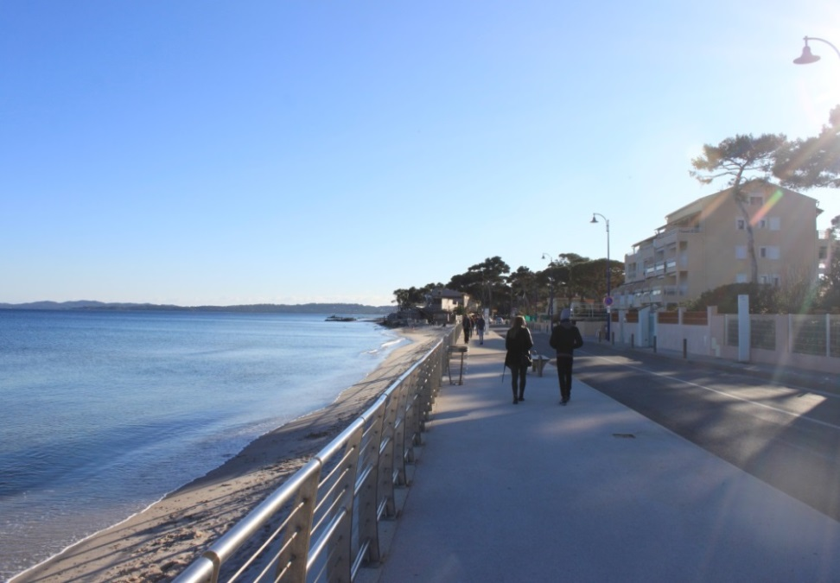
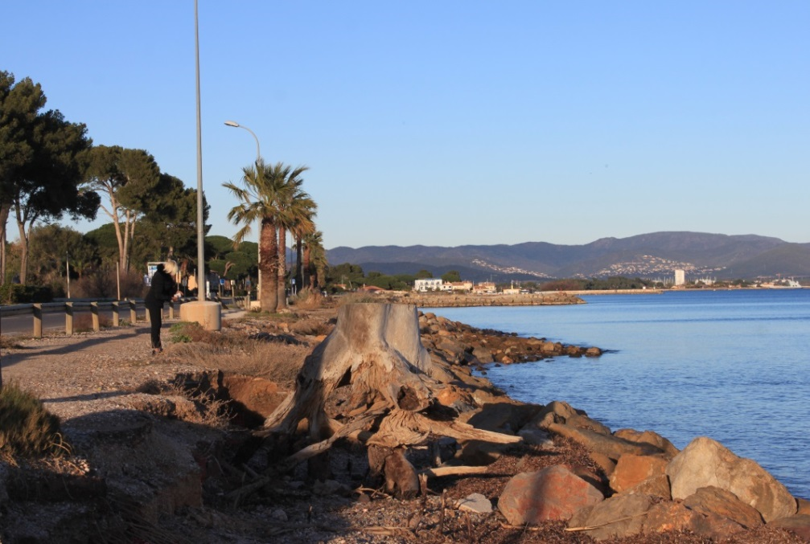
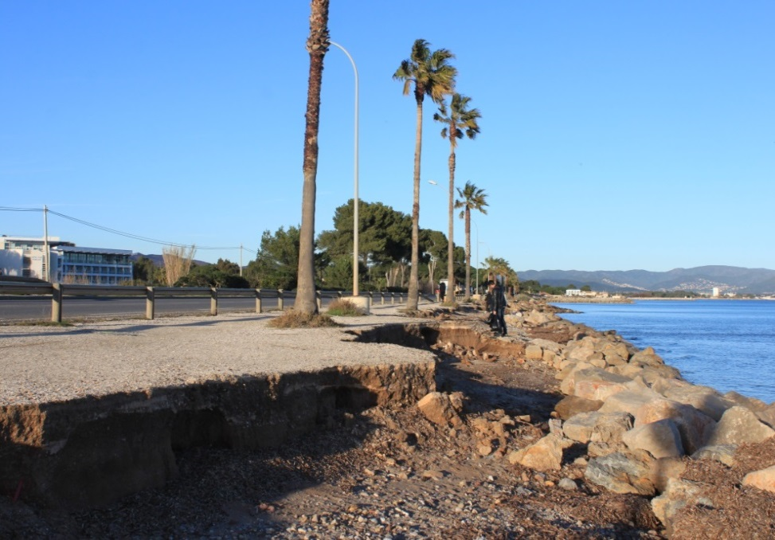
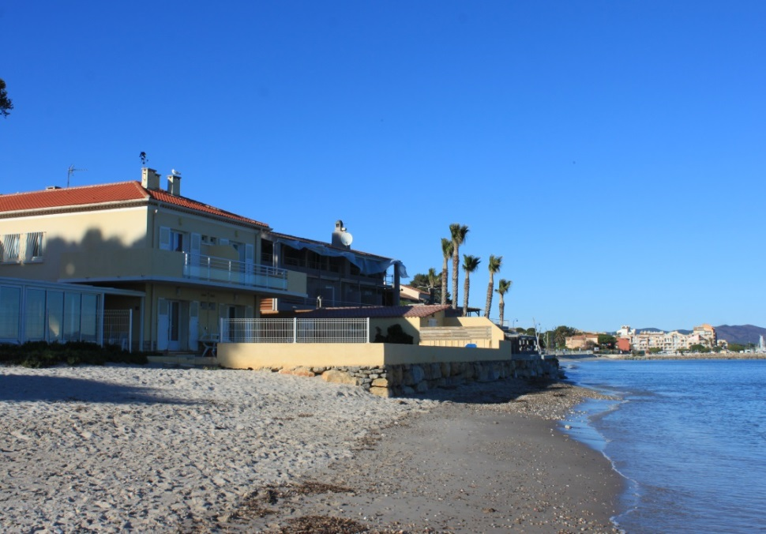
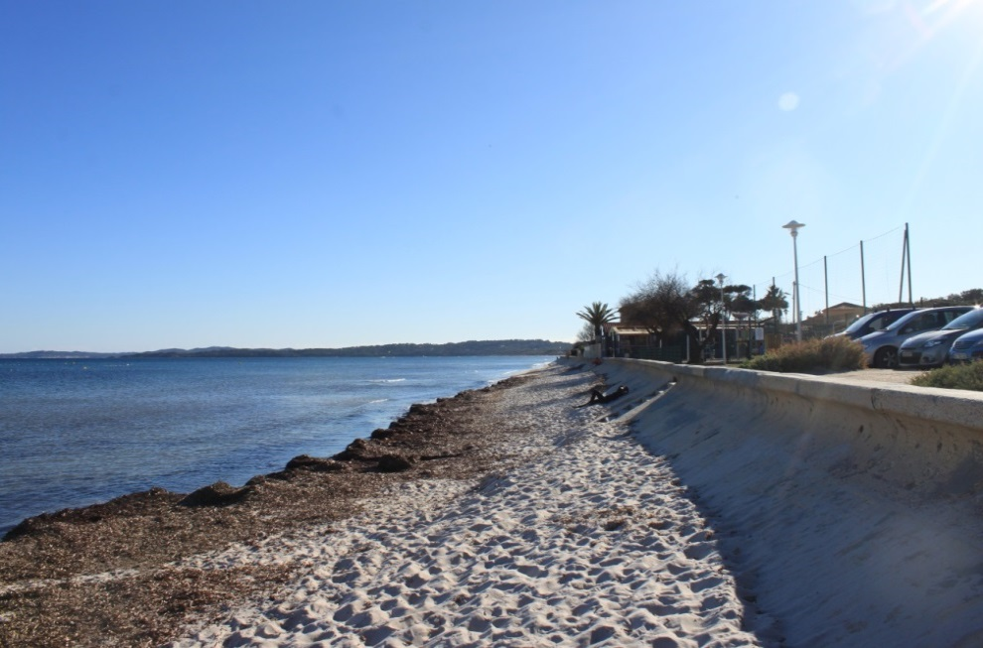
1. INTRODUCTION
Although some protective works have been placed, severe erosion still occurs in some areas.
2009
(Oceanide)
2008
(Capanni)
2003
(Oceanide)
2008
(Oceanide)
South
of
Bona
beach
North
of
Bona
beach
La Capte
beach
Pesquiers
beach
Ceinturon
beach
2018

Slide 6
1. INTRODUCTION
The main objectives of this thesis:
to investigate the changes in coastal hydrodynamic and sediment transport conditions,
to determine main causes of coastal erosion,
to design the most suitable coastal protection structure,
to predict the effects of this structure on beach morphology.

Slide 7
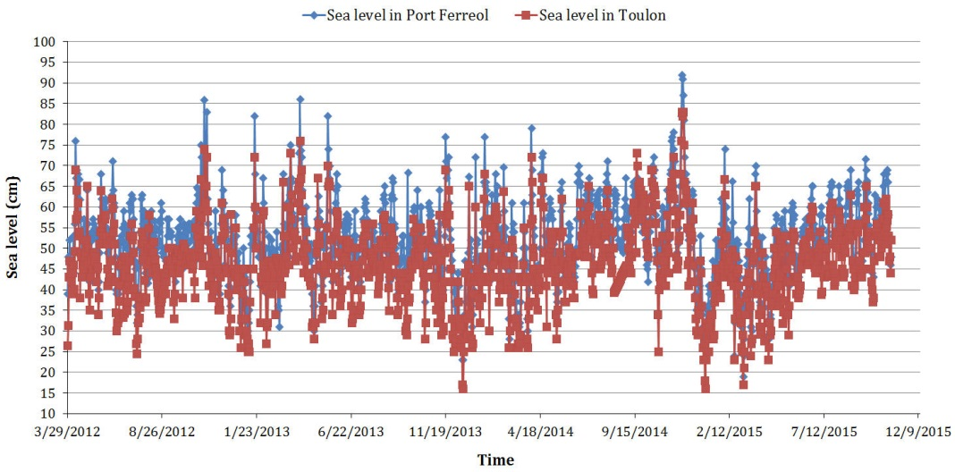
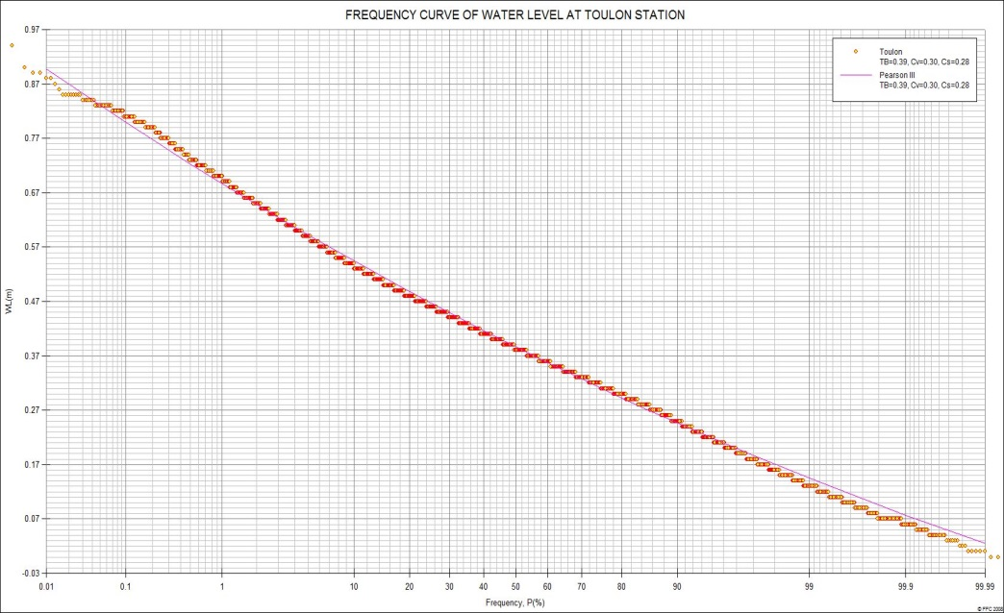
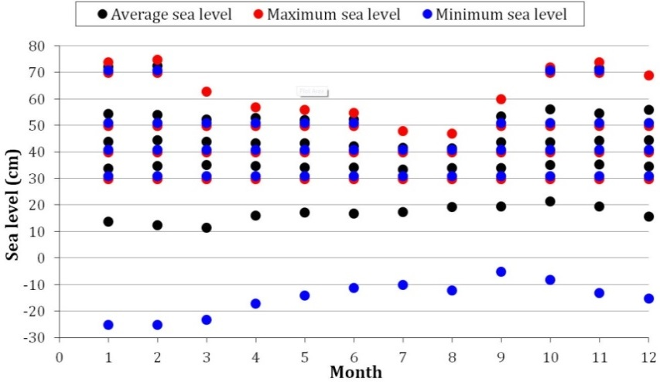
2. SITE DESCRIPTION
2.1. Sea level and tides
The tide patterns: an irregular semi-diurnal tide with low tidal range of 20 cm and seldom exceeding 30 cm.
Tidal range in case of storm surges: + 55.3 cm to + 65.3 cm above CM.
The mean sea level (MSL): +39 cm above CM.

Slide 8
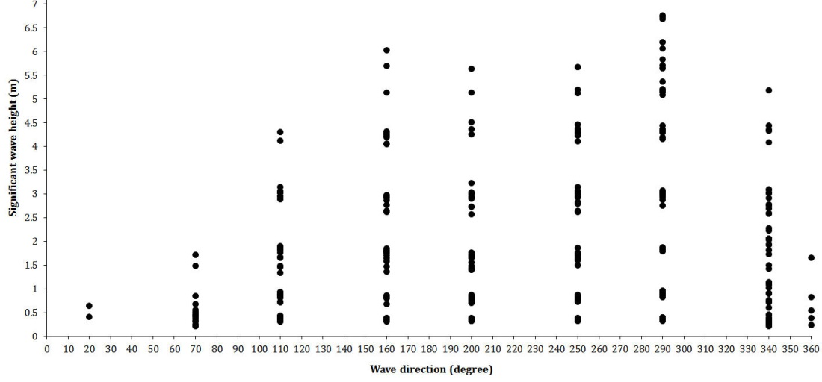
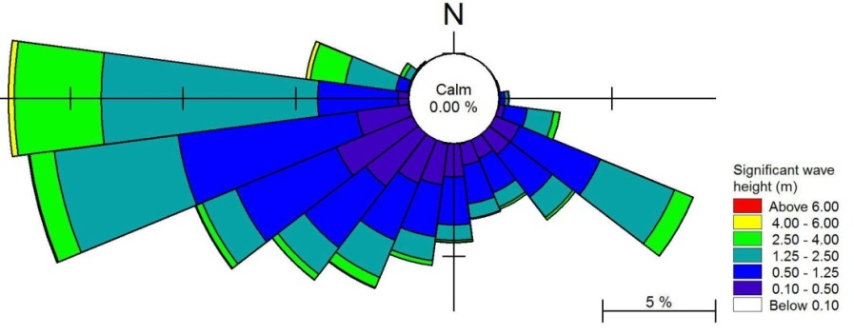
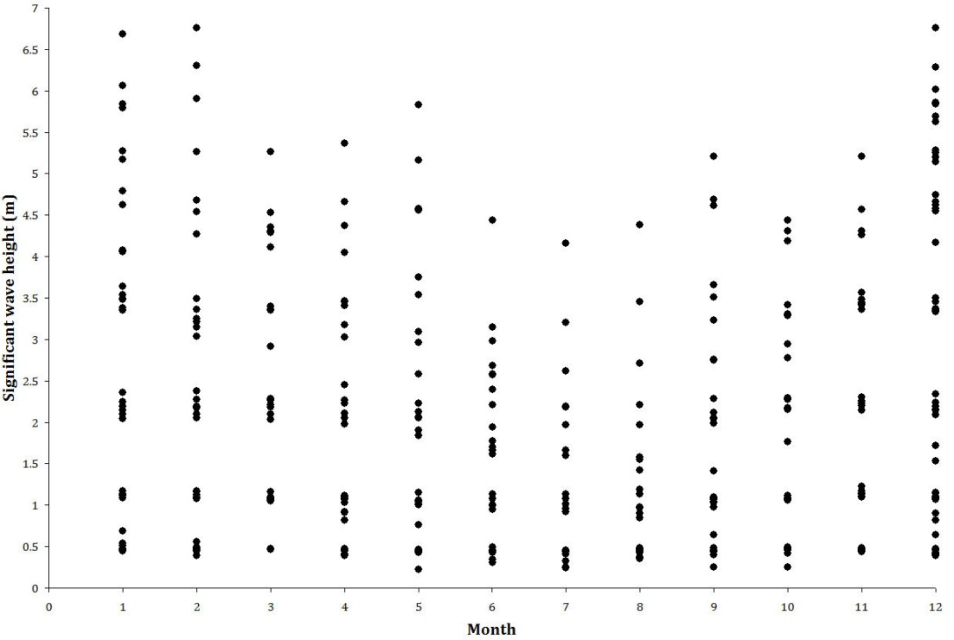
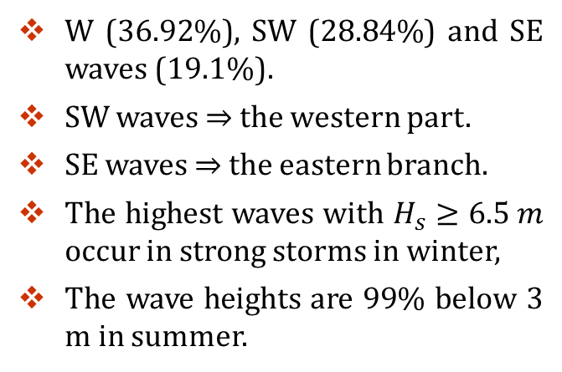
2. SITE DESCRIPTION
2.2. Waves
Rose of waves in Porquerolles island from 1992 to 2015.
W (36.92%), SW (28.84%) and SE waves (19.1%).
SW waves ⇒ the western part.
SE waves ⇒ the eastern branch.
The highest waves with $H_{s}≥6.5 m$ occur in strong storms in winter,
The wave heights are 99% below 3 m in summer.
Because of low tidal range, waves have the large influence on the coastal morphology of the eastern Giens tombolo (Sogreah, 1988).

Slide 9
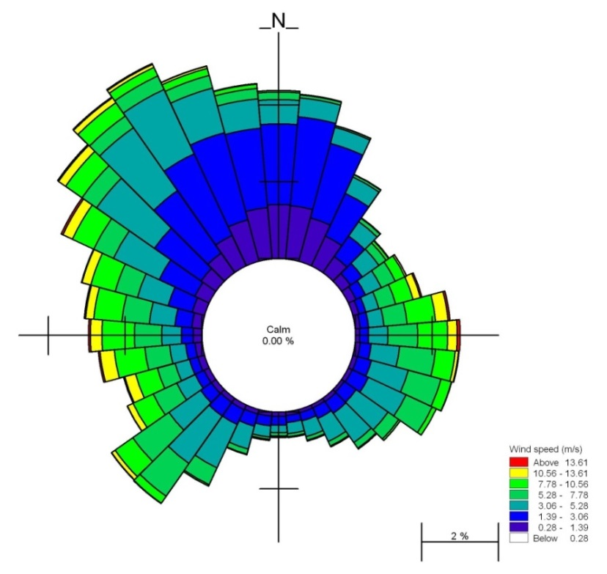
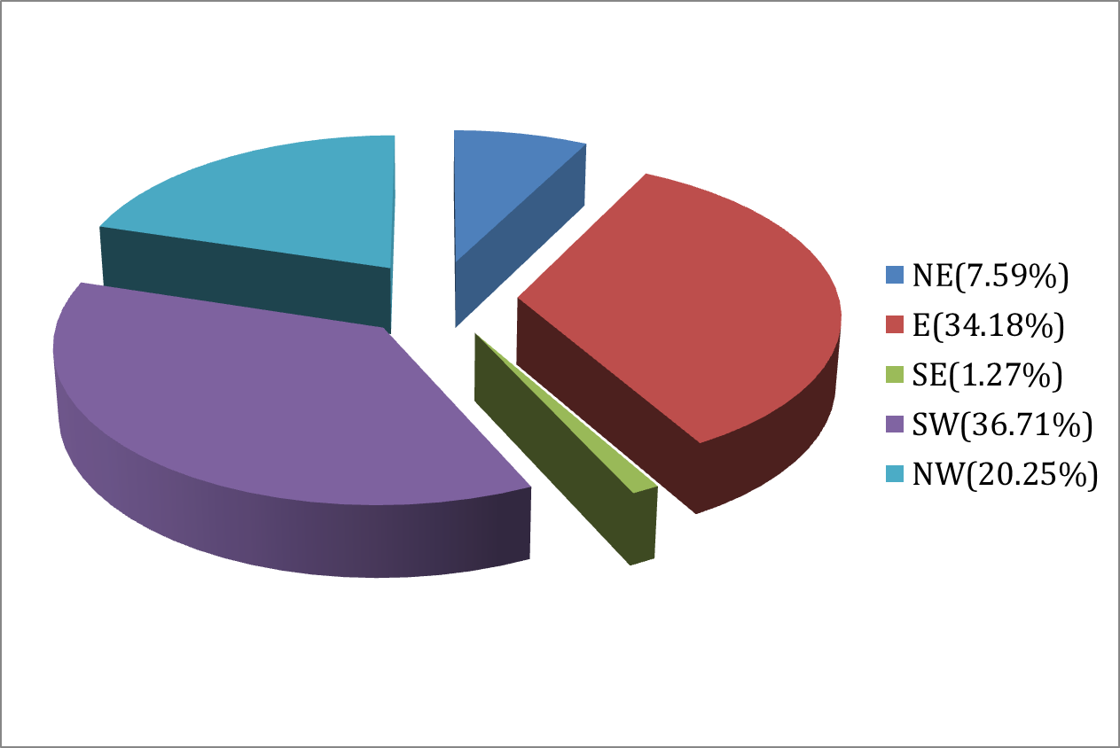
2. SITE DESCRIPTION
2.3. Winds
NE, E and SE winds (28.07% of total regime) ⇒the incident waves to the coast of Hyères bay.
W and SW winds (25.66%) ⇒ wave agitation and the coastal morphology in Giens gulf.
In the summer: SW (20.89%) and SE (12%) winds,
In the winter: NW (36.75%) and NE (9.32%) winds.
2.4. Rough seas and Storms
Most of storms approached the coast of Hyères bay from the east sector.
Most of rough seas and storms in the winter (December-February).
The strongest storm (24th, January, 2007): H_{s}=6.8 m, ≈the tri-decadal storm.
Rose of winds in B.A.N. Hyères station for the period 1999-2015.

Slide 10
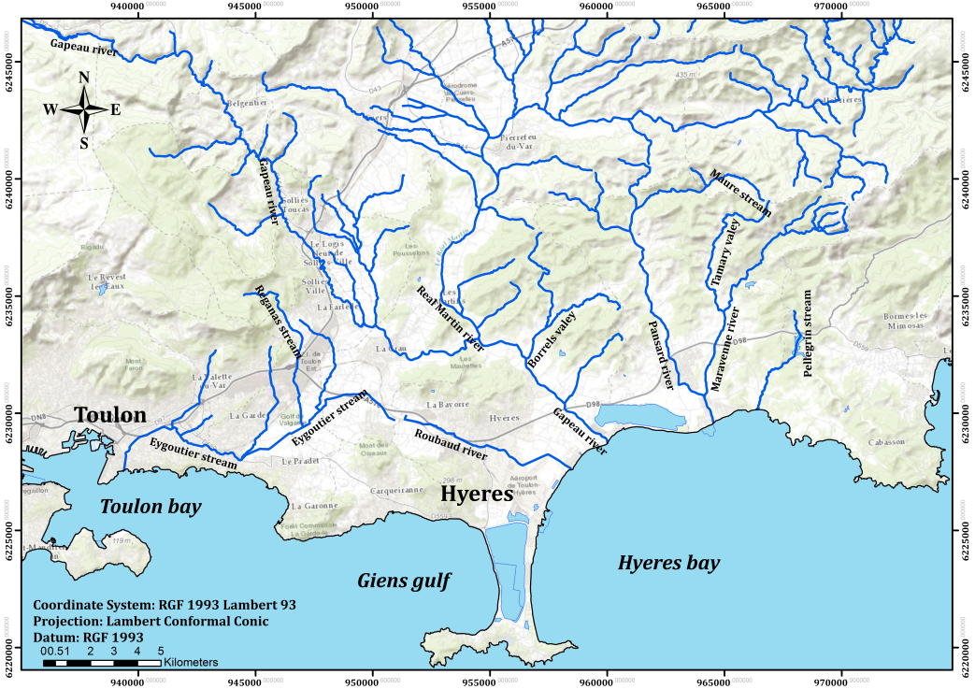
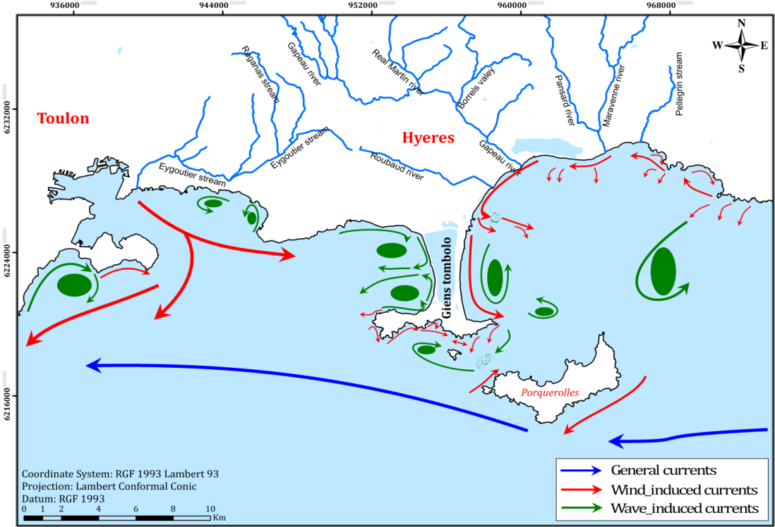
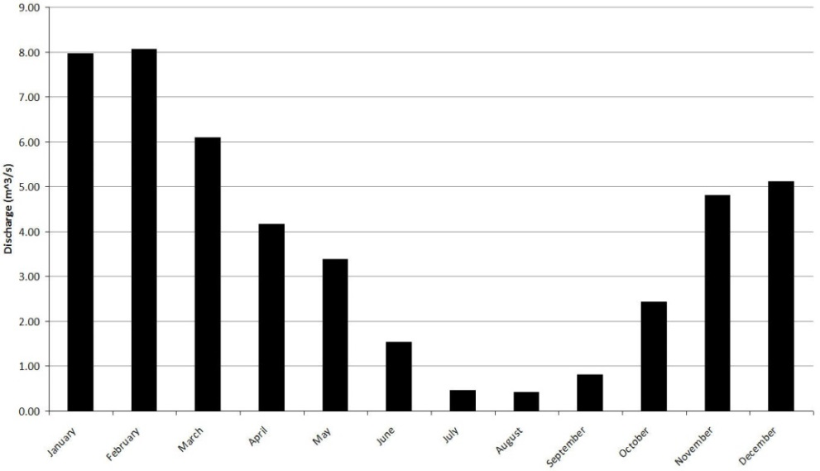
2. SITE DESCRIPTION
2.5. River flow and sea currents
The current map (Jeudy De Grissac (1975)).
General (blue) and tidal currents are weak in Hyères bay.
Wave-induced (green) currents ⇒sediment transport in Giens,
Wind-induced (red) currents ⇒sediment distribution in Hyeres bay.
Q_{annual} = 4 m³/s

Slide 11
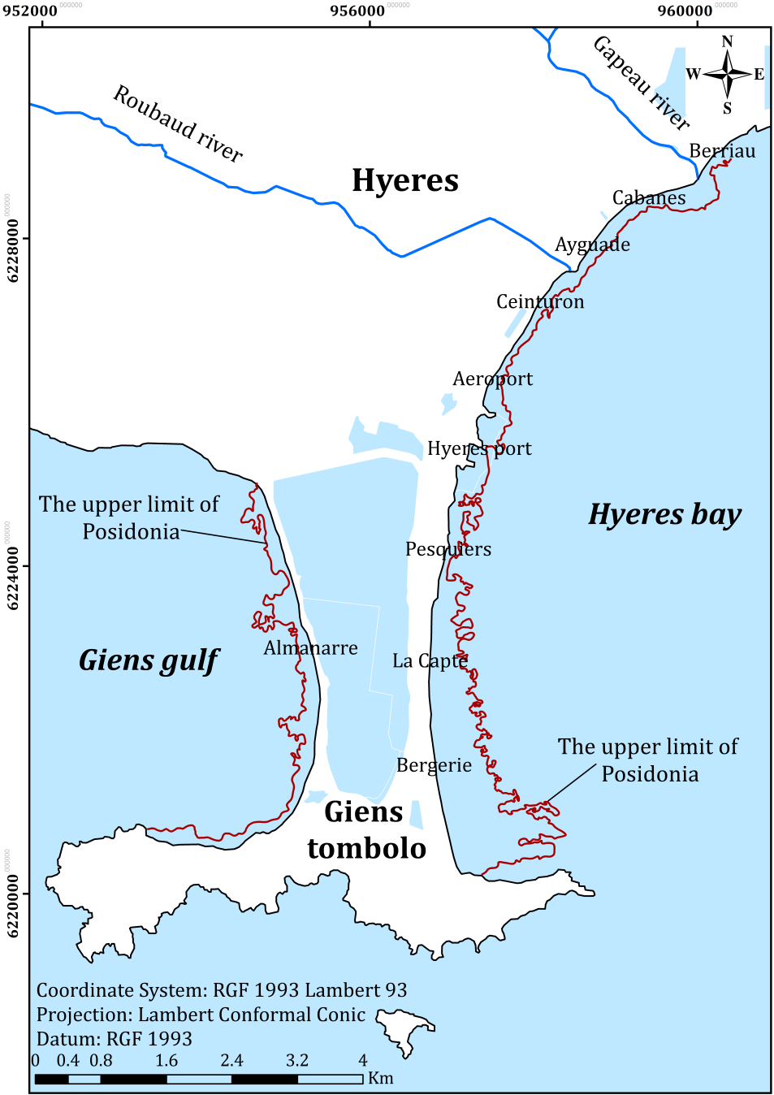
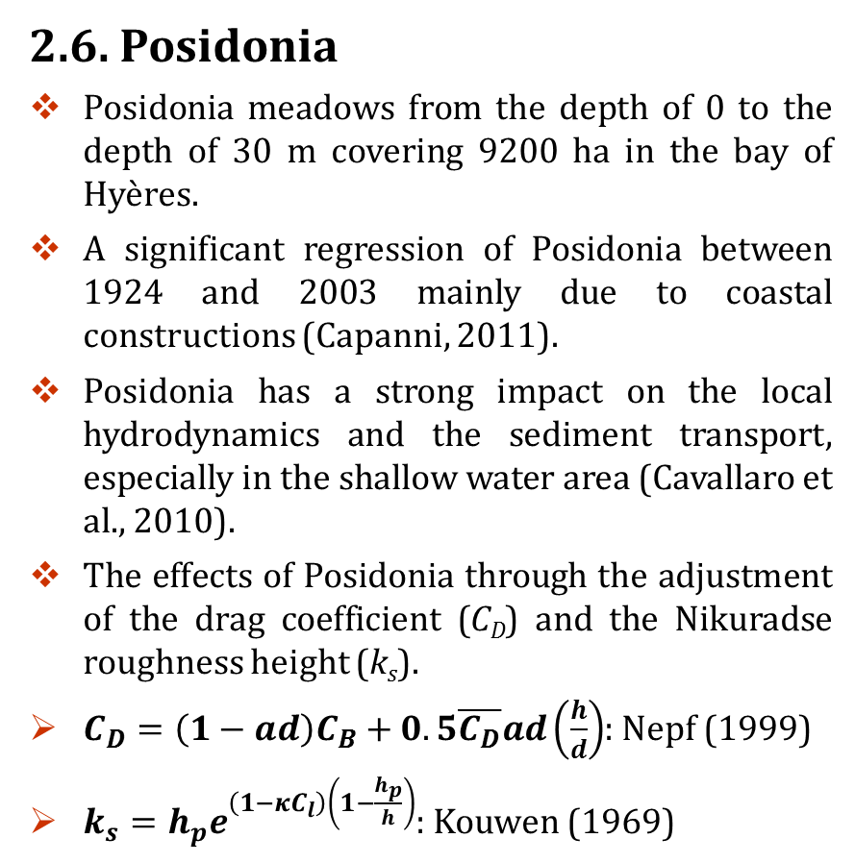
2. SITE DESCRIPTION
2.6. Posidonia
Posidonia meadows from the depth of 0 to the depth of 30 m covering 9200 ha in the bay of Hyères.
A significant regression of Posidonia between 1924 and 2003 mainly due to coastal constructions (Capanni, 2011).
Posidonia has a strong impact on the local hydrodynamics and the sediment transport, especially in the shallow water area (Cavallaro et al., 2010).
The effects of Posidonia through the adjustment of the drag coefficient (C_{D}) and the Nikuradse roughness height (k_{s}).
$C_{D}=\left(1−ad\right)C_{B}+0.5\overline{C_{D}}ad\left(\frac{h}{d}\right)$: Nepf (1999)
$k_{s}=h_{p}e^{\left(1−κC_{l}\right)\left(1−\frac{h_{p}}{h}\right)}$: Kouwen (1969)

Slide 12
3. METHODOLOGY
Data acquisition and preprocessing
Posidonia
Wind
Offshore wave
Sea level
Current
Bathymetry and sediment
Satellite images
2D numerical model
Mike21 HD, SW for Regional scale
EBP models
Image processing
Simulated sea level and current
Simulated wave
Beach nourishment design
Shoreline extraction and delineation
Mike21 coupled models for Regional scale
LITLINE
DSAS and Linear regression method
Nearshore wave
Nearshore current
Nearshore sediment drift
Nearshore bed changes
Short-term shoreline changes
Historical shoreline changes
Medium-term future shoreline changes
1D numerical model
Analytical model
SBWs design
Mike21 coupled models for Regional scale with SBWs
LITLINE
Nearshore wave with SBWs
Nearshore current with SBWs
Nearshore sediment drift with SBWs
Nearshore bed changes with SBWs
Short-term shoreline changes with SBWs

Slide 13
3. METHODOLOGY
3.1. The 2D numerical models of ST, SW, ST
Sensitivity analysis for choosing mesh
Regional area
(Coarse mesh)
(Giens-Hyeres bays)
Wave boundary conditions
Local area
(Fine mesh)
(The eastern coast)
SW
The best regional mesh
The best local mesh
Regional model calibration
(HD and SW)
HD
Local model calibration
(HD, SW and ST)
Hydrodynamic boundary conditions
SW
Calibrated parameters
(M and k_{s})
Calibrated parameters
(D₅₀, M, k_{s} and Posidonia characteristic)
HD
Hydrodynamic boundary conditions
Local main simulations
Regional main simulations
SW
HD
SW
ST

Slide 14
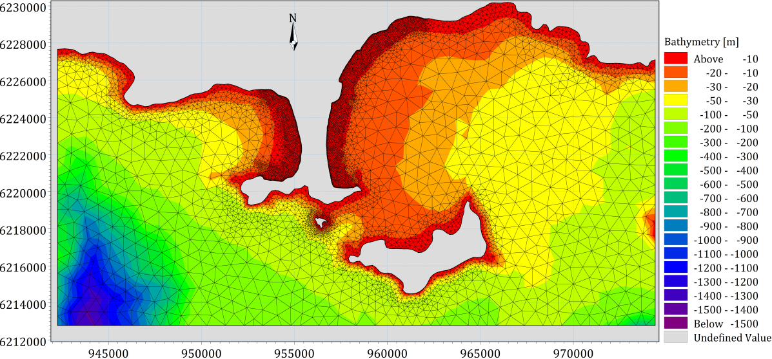
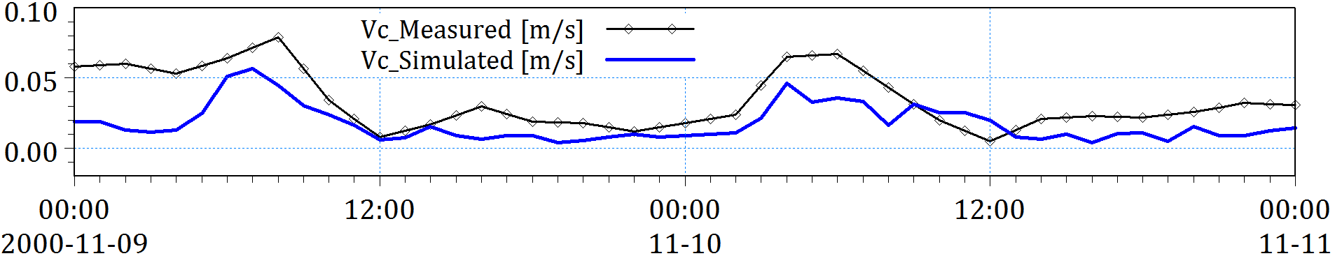
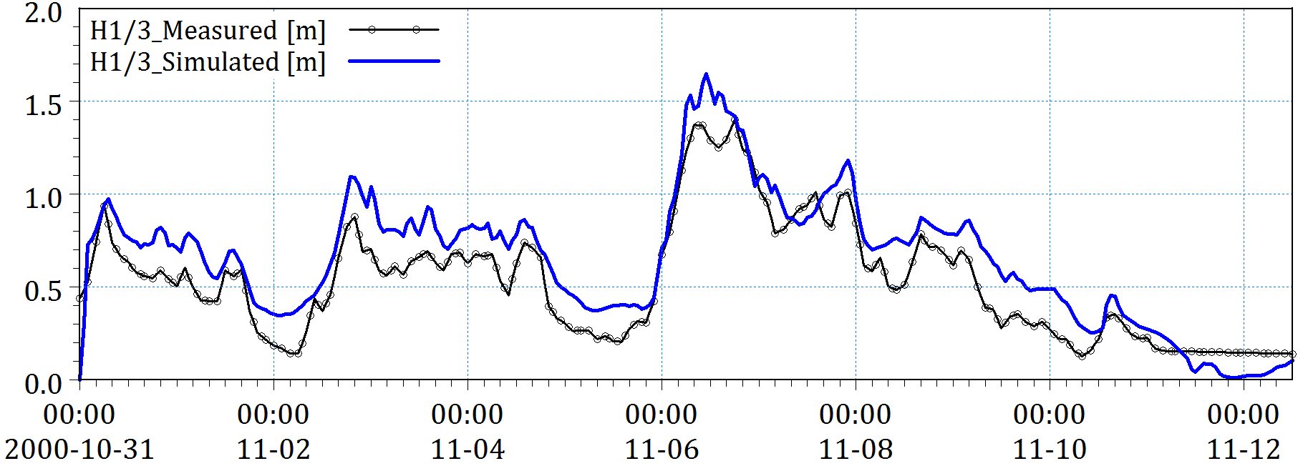
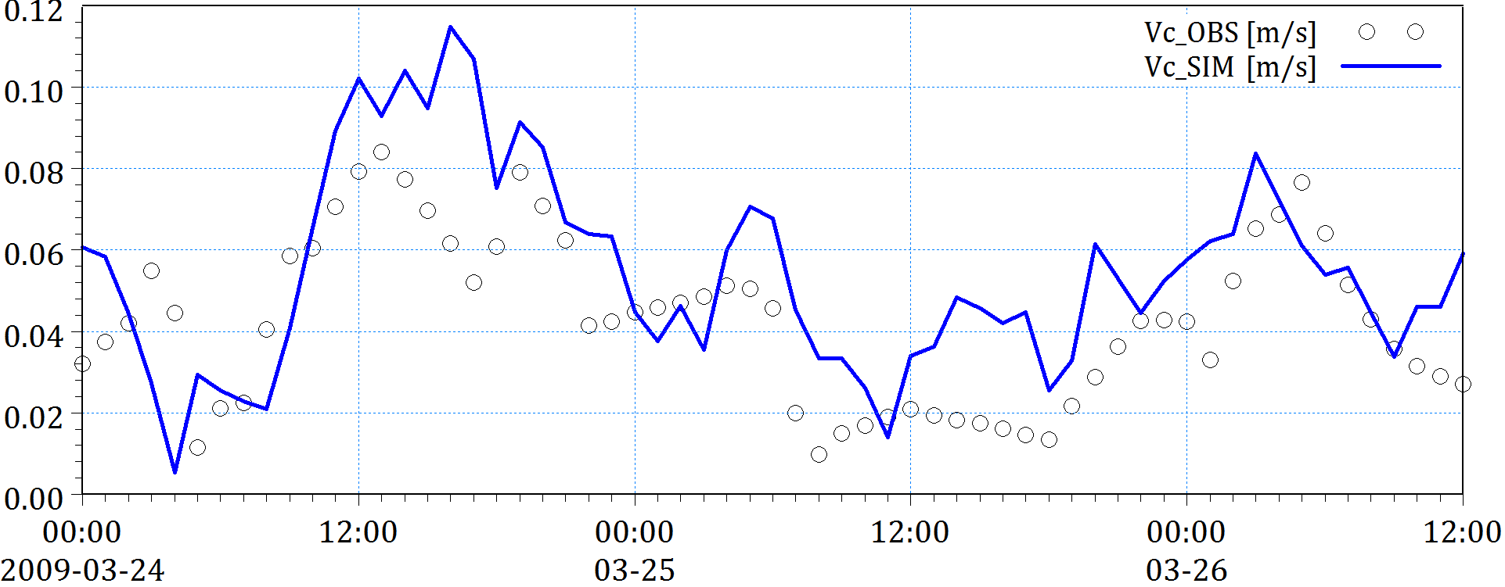
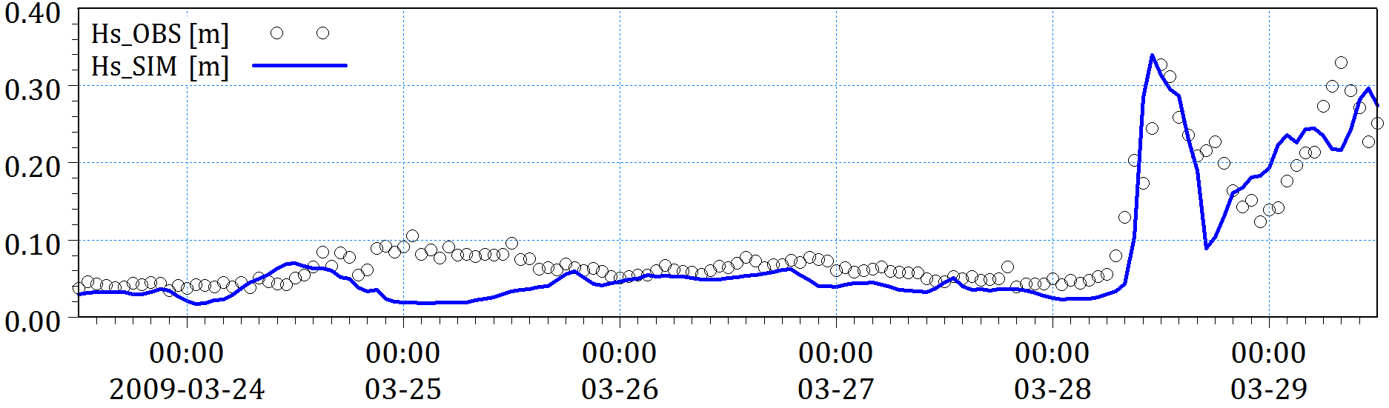
3. METHODOLOGY
3.1. The 2D numerical models of ST, SW, ST
Current speed
Regional mesh with 12,053 elements
Wave height
Case | R² | RMSE | SI
HD_M=20 | 0.537 | 0.014 | 0.405
SW_k_{s}=0.04 | 0.912 | 0.091 | 0.166
Case | R² | RMSE | SI
HD_M=20 | 0.795 | 0.032 | 0.349
SW_k_{s}=0.04 | 0.515 | 0.014 | 0.332
Calibration based on the data measured at Almanarre in November 2000
Wave height
Current speed
Validation based on the data measured at La Capte in March 2009

Slide 15
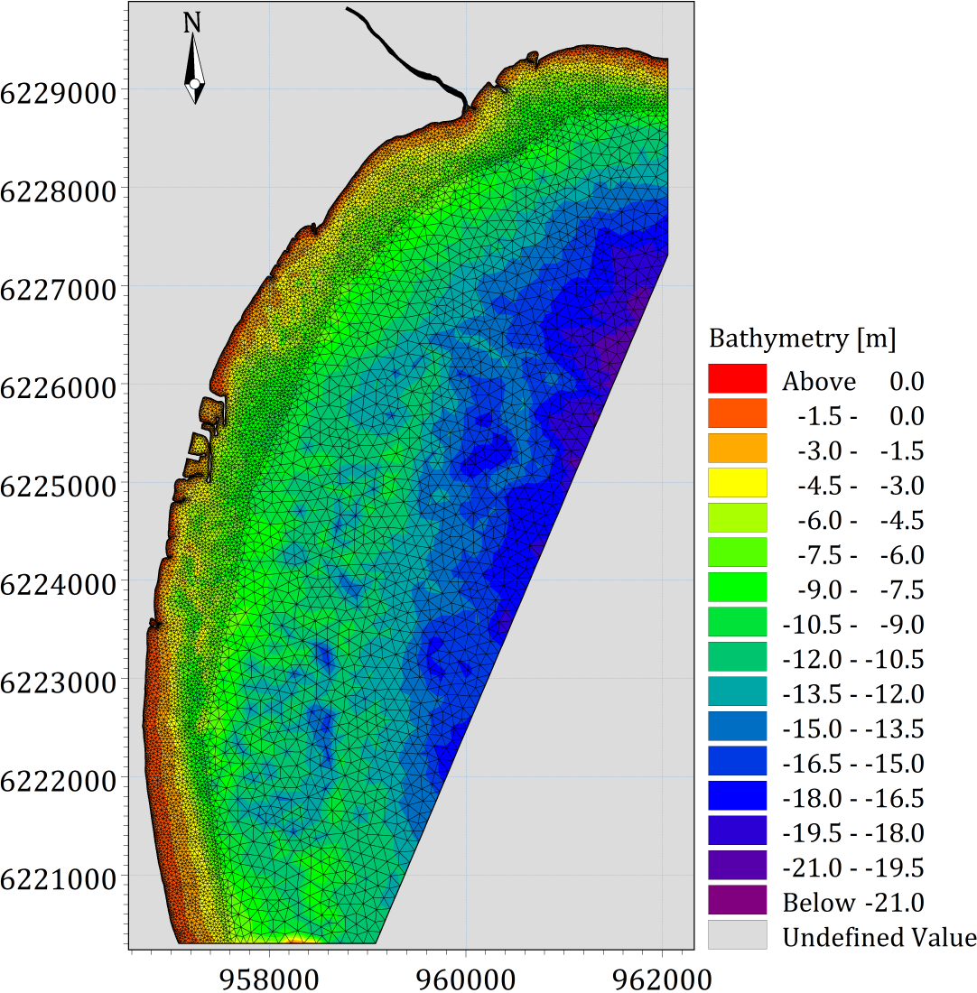
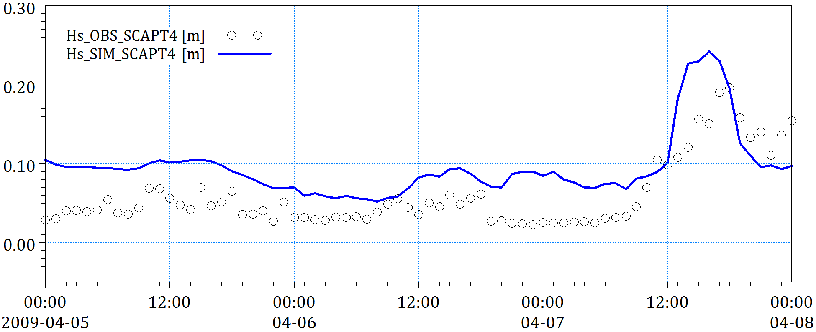


3. METHODOLOGY
3.1. The 2D numerical models of ST, SW, ST
Wave height
Current speed
BSS = 0.61
Local mesh with 22,960 elements
Case | R² | RMSE | SI
H_{s}_OBS vs H_{s}_SIM_SCAPT4 | 0.820 | 0.036 | 0.412
V_{c}_OBS vs V_{c}_SIM_SCAPT4 | 0.435 | 0.016 | 0.339
Beach profile
Calibration based on the data measured at La Capte and Aeroport beaches

Slide 16
3. METHODOLOGY
3.1. The 2D numerical models of ST, SW, ST
Scenarios | Sea level (m) |  | Wind |  | Offshore Wave |  |  | Discharge flow (m³/s)
 | No SLR | SLR | Speed (m/s) | Direction (º) | H_{s} (m) | T_{p} (s) | MWD (º)
Annual | 0.39 | 0.50 | 8.5 | 60 (NE) | 2.18 | 7.43 | 115 | 4
 |  |  | 6.48 | 90 (E)
 |  |  | 5.22 | 120 (SE)
Winter (February, 2007) | Measured data at Toulon port | - | Measured data at Hyeres station |  | Measured data at Buoy 08301 (Porquerolles) |  |  | Measured data at Sainte Eulalie (Gapeau river)
Summer (July, 2007) |  | -
Decadal storm | 0.95 | 1.30 | 12.55 | 90 | 6.56 | 9.12 | 80 | 180
 |  |  |  | 120 |  |  | 110
Tri-Decadal storm | 1.00 | 1.35 | 19.83 | 90 | 7.10 | 10.3 | 80 | 220
 |  |  |  | 120 |  |  | 110
Semi-Centennial storm | 1.15 | 1.50 | 29.59 | 90 | 7.34 | 11.0 | 80 | 300
 |  |  |  | 120 |  |  | 110
Centennial storm | 1.50 | 1.85 | 36.43 | 90 | 7.64 | 12.0 | 80 | 600
 |  |  |  | 120 |  |  | 110

Slide 17


3. METHODOLOGY
3.2. The numerical model of shoreline evolution
Simulated current and sea level
Simulated wave
Bathymetry and sediment
Initial shoreline position
LITLINE
Calibration
(H_{active} and D₅₀)
Ceinturon beach
Predicted shoreline position
Beach | Case | R² | RMSE | SI | BSS
Ceinturon | OBS_2008 vs SIM_2008 | 0.998 | 1.23 | 0.007 | 0.839
Bona | OBS_2008 vs SIM_2008 | 0.988 | 2.07 | 0.01 | 0.33
Bona beach

Slide 18


3. METHODOLOGY
3.3. The analytical model of shoreline evolution
Download Satellite images (1973-2015)
Image processing
-Radiometric calibration,
-Atmospheric correction,
-Gapfill,
-Pan-Sharpening,
-Geometric rectification
R² = 0.981
RMSE = 6.57
Coastline extraction and delineation by using Matlab code
Baseline and shorelines (1973-2015)
DSAS
-Transect lines,
-Intersection points,
-Rate of shoreline movement,
-Linear regression rate
Historical shoreline changes (1973-2015)
Prediction of future shoreline position by using Matlab code
Calibration and validation

Slide 19


3. METHODOLOGY
3.4. The EBP models
Dean (1977) model: $d=A.x^{2/3}$
Vellinga (1987) model:
$\left(\frac{7.6}{H_{os}}\right)d=0.47{\left[{\left(\frac{7.6}{H_{os}}\right)}^{1.28}{\left(\frac{w}{0.0268}\right)}^{0.56}+18\right]}^{0.5}$
Romańczyk et al. (2005) model:
$d=A.{\left(x+x_{s}\right)}^{ρ}$
Bodge (1992) model:
$d=B. \left(1−e^{−kx}\right)$
Komar et al. (1994) model:
$d=\frac{S_{o}}{k}\left(1−e^{−kx}\right)$
Sierra et al. (1994) model:
$d=G.\left[lnF+ln\left(x+x_{o}\right)\right]$
Lee (1994) model:
$d=\frac{1}{D}ln\left(\frac{x}{C}+1\right)$

Slide 20


4. DISCUSSION OF MORPHOLOGICAL CHANGES
4.1. Shoreline changes
Maximum erosion rates from 1973 to 2015 using LRR method:
Zone 1: -1.05 m/year
Zone 2: -0.77 m/year
Zone 3: -0.44 m/year
Zone 4: -0.29 m/year
Zone 5: -0.27 m/year.
Maximum accrtion rates from 1973 to 2015 observed in the upstream of shore-normal structures.
Historical shorelines and shoreline change rates using LRR method in the eastern Giens tombolo over period of 1973-2015

Slide 21


4. DISCUSSION OF MORPHOLOGICAL CHANGES
4.1. Shoreline changes
Maximum erosion rates from 2015 to 2050 using EPR method:
Zone 1: -1.25 m/year;
Zone 2: -0.89 m/year;
Zone 3: -0.66 m/year;
Zone 4: -0.61 m/year;
Zone 5: -0.45 m/year.
The DR 42 road running along Ceinturon can be disappeared in 2050 due erosion.
“Vu Minh Tuan et al. (2017). Application of geospatial techniques for prediction of shoreline changes in Almanarre beach, France. Indian Journal of Geo-Marine Science (Accepted).”
Future shorelines and shoreline change rates using EPR method in the eastern Giens tombolo over period of 2015-2050

Slide 22
4. DISCUSSION OF MORPHOLOGICAL CHANGES
4.2. Beach profile changes
Plein Sud beach
Pesquiers beach
The best-fit EBP of Vellinga;
E = -39.41 m².
The best-fit EBP of Bodge;
E = -82 m².
Bona beach
The shape of EBP at each beach support to design future beach nourishment projects.
“Vu Minh Tuan et al. (2017). Empirical equilirium beach profiles along the eastern tombolo of Giens. Journal of marine Science and Application (Accepted)”.
The best-fit EBP of Bodge;
E = -34.31 m².

Slide 23






5. DISCUSSION OF HD AND ST
5.1. Effects of wind direction
NE winds induce the highest waves in Bona.
The normal radiation stresses (S_{xx} & S_{yy}) ⇒ Cross-shore currents.
The shear radiation stresses (S_{xy} & S_{yx}) ⇒ Longshore currents.
Wave height
At Ceinturon, the currents induced by NE winds is 58% stronger than that in other directions.
At Bona, E and SE winds-generated currents are stronger than that due to NE winds.
Current speed
Northeast wind
East wind
Southeast wind

Slide 24






5. DISCUSSION OF HD AND ST
5.1. Effects of wind direction
At Ceinturon, Q_{max} generated by NE winds.
At Bona, Q_{max} generated by E and SE winds.
Sediment transport rates
NE winds cause the largest changes of the morphology of Ceinturon beach
E and SE winds have the highest impacts on the morphology of Bona beach.
Bed level change
Northeast wind
East wind
Southeast wind

Slide 25




5. DISCUSSION OF HD AND ST
5.2. Effects of seasonal changes
Winter
Summer
Winter
Summer
Wave height
Current speed
The mean significant wave height in the winter is 68%-122% higher than that in the summer.
The radiation stresses in winter are augmented by 110%-410% comparing those in the summer.
The increase of the mean current speed along the coast during the winter is about 6%-46.27%, apart from La Capte beach.
At the La Capte beach, the nearshore currents in the winter and the summer are not different so much.

Slide 26




5. DISCUSSION OF HD AND ST
5.2. Effects of seasonal changes
Winter
Summer
Winter
Summer
Sediment transport rates
Bed level change
Q in the winter are about 180%-800% higher than those in the summer.
Q_{max} from Gapeau to Aygaude beach
Q_{min} at Badine beach.
Quite stable seabed in the summer.
Erosion along the eastern Giens tombolo in winter.
Winter climate plays a decisive role in morphological evolution of beaches.

Slide 27








5. DISCUSSION OF HD AND ST
5.3. Effects of extreme events
The highest significant wave heights in Bona beach.
Wave height
The current speed is intensified with the increase of storm level.
The highest current speed in Aygaude beach.
Current speed
Decadal
storm
Tri-Decadal
storm
Semi-Centennial
storm
Centennial
storm

Slide 28




5. DISCUSSION OF HD AND ST
5.3. Effects of extreme events
Decadal storm
Tri-Decadal storm
Semi-Centennial storm
Centennial storm
Bed level change
Notable accretion: Hyères port, Pesquiers beach, and La Capte beach.
The most serious erosion: Aygaude beach, Ceinturon beach and Bona beach,
An increase of the storm intensification provokes the augmentation of erosion level.
The storms cause extremely large and quick changes in beach morphology.

Slide 29






5. DISCUSSION OF HD AND ST
5.4. Effects of Posidonia seagrass
H_{S} increases by 3.54%-6.05% at Bona beach and 17.58%-19.15% at Ceinturon beach.
Posidonia
The radiation stresses are boosted by 43.27%-55.14% at Ceinturon beach and 9.46%-49.96% at Bona beach.
No Posidonia
Northeast wind
East wind
Southeast wind

Slide 30




5. DISCUSSION OF HD AND ST
5.4. Effects of Posidonia seagrass
H_{S} in both the winter and summer are intensified up to 29.53%-45.60% at Ceinturon beach and 33.97%-83.54% at Bona beach.
Posidonia
The radiation stresses in both winter and summer are 65.33%-103.06% at Ceinturon beach and 51.50-260.97% at Bona beach.
No Posidonia
Winter
Summer

Slide 31








5. DISCUSSION OF HD AND ST
5.4. Effects of Posidonia seagrass
H_{S} is boosted viz. by 33.84%-47.86% at Ceinturon beach and by 18.01%-22.52% at Bona beach.
Posidonia
The radiation stresses can be increased by 99.91%-202.17% at Ceinturon beach and 49.51%-249.14% at Bona beach.
No Posidonia
Decadal storm
Tri-Decadal storm
Semi-Centennial storm
Centennial storm

Slide 32






5. DISCUSSION OF HD AND ST
5.4. Effects of Posidonia seagrass
V_{c} at Ceinturon and Bona beaches increased by 99.7%-185.4% and 2.03-36.18%, respectively.
Posidonia
The NE winds predominantly affect the current field.
No Posidonia
Northeast wind
East wind
Southeast wind

Slide 33




5. DISCUSSION OF HD AND ST
5.4. Effects of Posidonia seagrass
The difference of current speed between in the winter and summer are not different so much without Posidonia.
Posidonia
V_{c} increases by 127.1%-138.2% in Bona beach and 424%-555%, in Ceinturon beach without Posidonia
No Posidonia
Winter
Summer

Slide 34








5. DISCUSSION OF HD AND ST
5.4. Effects of Posidonia seagrass
V_{c} boosted by 24.65%-184.5% at Ceinturon beach and by 38.29%-360.1% at Bona beach.
Posidonia
“Vu Minh Tuan et al. (2017). Investigating the impacts of the regression of Posidonia oceanica on hydrodynamics and sediment transport in Giens Gulf. Ocean Engineering, 146, 70-86.”
No Posidonia
Decadal storm
Tri-Decadal storm
Semi-Centennial storm
Centennial storm

Slide 35


5. DISCUSSION OF HD AND ST
5.5. Effects of beach nourishment
Ceinturon
H_{S} in annual cases decreased by 6%-7% at Ceinturon.
S_{xy} inducing the longshore currents receded by 20% at Ceinturon.
Modeled cross-shore variations in wave height
Ceinturon
The largest reduction of 12.8% of V_{c} caused by the SE winds in Ceinturon.
Modeled cross-shore variations in current speed

Slide 36


5. DISCUSSION OF HD AND ST
5.5. Effects of beach nourishment
Ceinturon
H_{S} reduces by 3%-13.9% in the winter ,
H_{S} in the summer increases slightly by 3.41% in Ceinturon beach.
Modeled cross-shore variations in wave height
Ceinturon
V_{c} decreases by maximum 6.5% in Ceinturon beach in both the winter and summer.
Modeled cross-shore variations in current speed

Slide 37


5. DISCUSSION OF HD AND ST
5.5. Effects of beach nourishment
Ceinturon
H_{S} decreased by 12%-14% in Ceinturon beach in all storm scenarios.
Modeled cross-shore variations in wave height
Ceinturon
V_{c} in the stormy cases almost reduced by beach nourishment in Ceinturon.
Modeled cross-shore variations in current speed

Slide 38

5. DISCUSSION OF HD AND ST
5.5. Effects of beach nourishment
Beach profile evolution of Central Ceinturon with and without nourishment
Beach nourishment not enough for protection of beach and only effective in short-term with ordinary wave cases.

Slide 39
6. PROPOSAL OF PROTECTIVE MEASURE
6.1. Key design considerations for protective measure
Reducing the hydraulic loading to a required level.
Mitigating erosion on an existing beach.
Diminishing the blockage of littoral sediment drift and sediment trapping.
Without destroying or reducing beach amenity or aesthetics.
Providing water flow circulation.
Easy to install and can be constructed locally, relatively cheap, suitable for weak soil and flexible to allow for settlements.
Avoiding the negative impacts on Posidonia.

Slide 40


6. PROPOSAL OF PROTECTIVE MEASURE
6.2. Design layout and cross-section of protective measure
Main dimensions:
Distance from shoreline:
X (m) = 80-90 m
Length of breakwater:
L_{s} (m) = 110-120 m
Crest width of breakwater:
B_{c} (m) = 20 m
Gap between two segments:
G (m) = 60-70 m
Crest elevation of breakwater: +0.0 m
MSL: +0.39 m
Median diameter of rock:
D₅₀ (m) = 0.5-0.6 m
Ceinturon
Bona

Slide 41






6. PROPOSAL OF PROTECTIVE MEASURE
6.3. Effects of SBWs on wave fields
Ceinturon
No SBWs
Ceinturon
SBWs
Northeast wind
East wind
Southeast wind
H_{s} reduces by 61.69%-71.16% in the leeside of SBWs and less than 26.16% in the gaps between SBWs.

Slide 42




6. PROPOSAL OF PROTECTIVE MEASURE
6.3. Effects of SBWs on wave fields
Ceinturon
No SBWs
Ceinturon
SBWs
Summer
Winter
In the leeside: H_{s} decreased 52.08%-56.84% in winter; 42.22%-44.41% in summer.
In the gaps between SBWs: H_{s} reduced about 3.42%-32.38% in summer and winter.

Slide 43








6. PROPOSAL OF PROTECTIVE MEASURE
6.3. Effects of SBWs on wave fields
Ceinturon
No SBWs
Ceinturon
SBWs
Decadal storm
Tri-Decadal storm
Semi-centennial storm
Centennial storm
K_{t} in the leeside is 0.48-0.54 in the decadal storm, 0.52-0.58 in the tri-decadal storm, 0.57-0.62 in the semi-centennial, and 0.63-0.67 in the centennial storm;
K_{t} varies 0.74-0.91 in the gaps of SBWs.
The wave energy dissipation efficiency of SBWs reduces if level of storm increases.

Slide 44




6. PROPOSAL OF PROTECTIVE MEASURE
6.4. Effects of SBWs on bathymetry evolution
Ceinturon
Ceinturon
Northeast wind
Bathymetry changes due to annual conditions
The erosive area (S_{e}) decreases by 36.55%-79.2% behind the SBWs and 29.1%-75% in the gaps of SBWs.

Slide 45




6. PROPOSAL OF PROTECTIVE MEASURE
6.4. Effects of SBWs on bathymetry evolution
Ceinturon
Ceinturon
Winter
Bathymetry changes in seasonal conditions
S_{e} in the leeside of SBWs reduces between 33.61% and 72.6% in both summer and winter.

Slide 46




6. PROPOSAL OF PROTECTIVE MEASURE
6.4. Effects of SBWs on bathymetry evolution
Ceinturon
Ceinturon
Centennial storm
Bathymetry changes in stormy conditions
S_{e} behind the SBWs reduces about 30%-91% in the leeside of SBWs.
Lower efficiency of SBWs under the impact of the semi-centennial and centennial storms.

Slide 47


6. PROPOSAL OF PROTECTIVE MEASURE
6.5. Effects of SBWs on shoreline change
Winter
In the winter:
Increase of the accretion area: 49.29 m² (10.14%).
Reduction of erosion area: -16.63 m² (5.12%).
The maximum salient: width of 3.0 m and the accretion area of +378 m².
Ceinturon
Summer
In the summer:
The maximum salient: width of 4.5 m and the total area of +384 m².
Increase of the accretion area: 259.29 m² (207.59%).
Erosion occurs in the gap between the first and second SBWs.
Ceinturon

Slide 48


6. PROPOSAL OF PROTECTIVE MEASURE
6.5. Effects of SBWs on shoreline change
Decadal storm
In the decadal storm:
Reduction of erosion area in central Ceinturon: -56 m² (32%).
The maximum salient amplitude of 2 m with the salient area of +250 m².
For entire Ceinturon: Reduction of erosion area of 13.3% and reduction of accretion area of 18.12%.
Ceinturon
Tri-Decadal storm
In tri-decadal storm:
Reduction of erosion area in central Ceinturon: 32%.
For entire Ceinturon: Reduction of erosion area of 13.69% and reduction of accretion area of 8.83%.
Ceinturon

Slide 49


6. PROPOSAL OF PROTECTIVE MEASURE
6.5. Effects of SBWs on shoreline change
Semi-Centennial storm
In semi-centennial storm:
For entire Ceinturon: Reduction of erosion area of 11.74% and reduction of accretion area of 10.64%.
Reduction of the erosive area in central Ceinturon from -279.4 m² to -202.1 m² (28%).
Ceinturon
In centennial storm:
Reduction of the erosive area in central Ceinturon from -290.7 m² to -235.3 m² (19.1%).
Centennial storm
Erosion still exists due to strong storms; but, the loss amount of beach area due to erosion with SBWs is much less than that without SBWs.
“Vu Minh Tuan et al. (2017). Investigation of shoreline changes in Ceinturon beach, Giens double tombolo, France. Mediterranean Marine Science (In Review).”
Ceinturon

Slide 50
7. CONCLUSIONS
The shore-normal structures mainly cause severe erosion in downstream areas.
The strongest impact of the northeast winds, except around Bona beach.
The decisive role of the winter climates in the beach morphological evolution along the eastern Giens tombolo.
The higher level of storm causes the larger and stronger impacts on hydrodynamics and sediment transport.
The main longshore current generally directs from north to south.
The regression of Posidonia in Hyères bay cause a considerable increase of hydrodynamics and sediment transport rate, specifically in storms.
Beach nourishment conducted annually is not an effective and long-term solution for protecting the beaches from coastal erosion.
SBWs plays a very important role in protecting central Ceinturon and Bona beaches.

Slide 51
PUBLICATIONS
Vu, M. T., Lacroix, Y., & Nguyen, V. T. (2017). Investigating the impacts of the regression of Posidonia oceanica on hydrodynamics and sediment transport in Giens Gulf. Ocean Engineering, 146, 70-86. doi: https://doi.org/10.1016/j.oceaneng.2017.09.051
Vu, M. T., & Lacroix, Y. (2017). Investigation of shoreline changes in Ceinturon beach, Giens double tombolo, France. Mediterranean Marine Science (In Review).
Vu, M. T., Lacroix, Y., & Nguyen, V. T. (2017). Empirical equilirium beach profiles along the eastern tombolo of Giens. Journal of marine Science and Application (Accepted).
Vu, M. T., Lacroix, Y., Than, V. V., & Nguyen, V. T. (2017). Application of geospatial techniques for prediction of shoreline changes in Almanarre beach, France. Indian Journal of Geo-Marine Science (Accepted).
Lacroix, Y., Vu, M. T., Than, V. V., & Nguyen, V. T. (2015). Modeling the effect of geotextile submerged breakwater on hydrodynamics in La Capte beach. Paper presented at the Vietnam-Japan Workshop on Estuaries, Coasts and Rivers, Hoi An, Vietnam.
Vu, M. T., & Lacroix, Y. (2018). Investigating the effects of sea-level rise on morphodynamics in the western Giens tombolo, France. Paper presented at the ICESE 2018, Barcelona, Spain.

Slide 52
Thank you
for your attention
& Educator

